Slide 1


Causal Mediation Analysis
Felix Thoemmes
GESIS Workshop 2024

Slide 2

Introduction
Notes:
Introduction
Name
Location
„One thing that you would like to learn“
„This workshop will be a success for me if…“

Slide 3
Personal introduction
Undergraduate student in Landau, Germany
M.A. student at Indiana State University
Ph.D. student at Arizona State University
Positions at Texas A&M University, University of Jena, University of Tübingen, Cornell University

Slide 4


Personal introduction
Student of Steve West, Craig Enders, and David MacKinnon at ASU
Work in missing data analysis, and causal inference
Notes:
For yourself: Name Discipline Rank Location

Slide 5
Introductions
Name Felix Thoemmes
Discipline (Quantitative) Psychology
Position Associate Professor
Location Cornell University, Ithaca, New York, US

Slide 6
Outline – Day 1
Review of statistical mediation
Examples and exercises in R
Potential outcomes and directed acyclic graphs

Slide 7
Outline – Day 2
Potential outcomes and directed acyclic graphs (cont.)
Introduction to causal mediation
More examples in R

Slide 8
Outline – Day 3
Assumptions of the causal mediation model
Estimation of the causal mediation model
Yet more R examples

Slide 9
Outline – Day 4
Sensitivity analysis
Alternative estimators

Slide 10
Outline – Day 5
Design-based inference
Bring your own data
Future directions

Slide 11
Causal mediation
Definitions
Assumptions
Estimation
Interpretation

Slide 12
Introduction

Slide 13
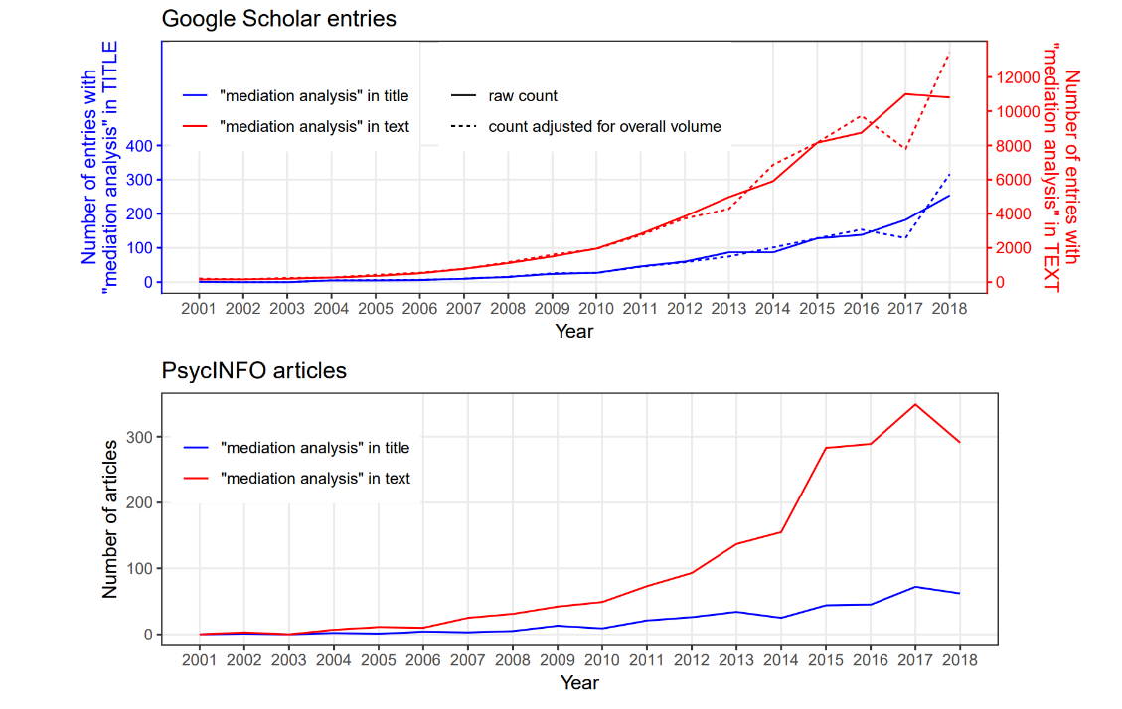
Why causal mediation analysis?
Credit: Nguyen, Schmid, & Stuart, Psych Methods, 2020
Notes:
2023: title – 400+
2023: text – 170,000

Slide 14
Why causal mediation analysis?
Effect definitions that are grounded in potential outcomes / DAG
Rigorous definitions of assumptions underlying causal effects
Accommodation of non-linear models and sensible effect definitions within those models

Slide 15
Statistical mediation

Slide 16

Notes:
Who has used statistical mediation models before? Baron and Kenny? Regression-type?

Slide 17
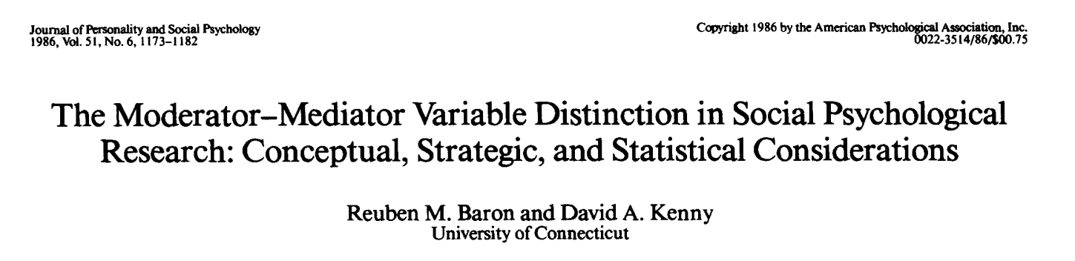
Statistical mediation
Notes:
The paper that started it all
Cited 14K times and still going strong

Slide 18
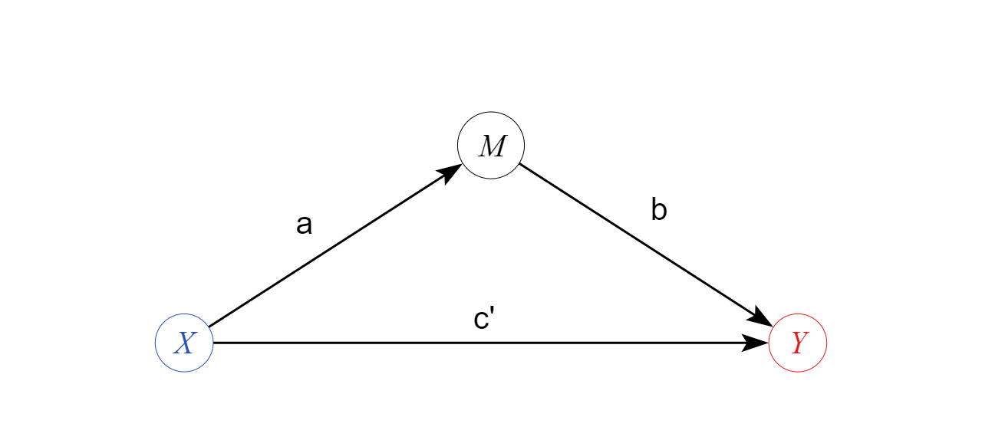
Tri-variate mediation model

Slide 19
Mediation
Mediation is defined as a model in which a variable X affects a variable Y through at least one mediator M
The effect of X on Y is often referred to as the total effect
This total effect is said to be decomposable into a direct effect and an indirect effect
The indirect effect is the effect that is mediated from X to Y via M
The remainder of the total effect that is not indirect (mediated) is called the direct effect

Slide 20
Mediation
Mediation is sometimes described as opening a black box between a cause and effect
It is used to describe a mechanism between two variables that explains why a particular variable X can have an effect on variable Y

Slide 21
Statistical mediation
Baron and Kenny described the underlying logic and statistical considerations of the mediation model
A putative cause, an effect of interest, and an observed mechanism (mediator)
Judd and Kenny (in a paper that preceded Baron and Kenny) also discussed that the path from M to Y can be subject to confounding and cannot easily causally interpreted

Slide 22




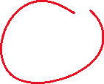

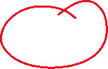





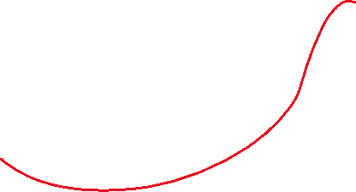
Statistical mediation
Baron and Kenny described a strategy of steps in mediation analysis
Examine effect of X on Y (c path)
Examine effect of X on M (a path)
Examine effect of M on Y, adjusting for X (b path)
Examine effect of X on Y, adjusting for M (c‘ path) and compare with X on Y (c – c‘) OR Examine product of a and b (a*b)

Slide 23



Statistical mediation
$Y=β_{0}+β_{1}X$
$Y=β_{0}+β_{1}X+β_{2}M$
$$M=β_{0}+β_{1}X$$

Slide 24

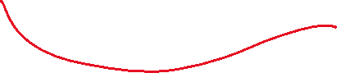

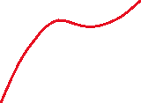

















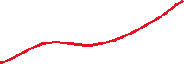
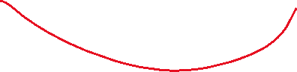
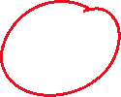


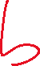
Statistical mediation
$Y=β_{0}+β_{1}X$
$Y=β_{0}+β_{1}X+β_{2}M$
$$M=β_{0}+β_{1}X$$

Slide 25



Statistical mediation
$Y=β_{0Y1}+cX$
$Y=β_{0Y2}+c′X+bM$
$$M=β_{0M}+aX$$

Slide 26
Statistical mediation
Applied researchers sometimes claim that their mediation model was purely descriptive
A mediation model is always an expression (and a commitment) to a causal interpretation and reading of the model
A mediation model is always a causal model!

Slide 27
Statistical mediation
Much of the focus of the statistical mediation paradigm was
On proper standard errors for product terms (delta method, numerical integration, bootstrap)
Extending the model to account for multiple mediators in sequence or in parallel
Extending the model to account for latent variables, multi-level data, or moderators

Slide 28
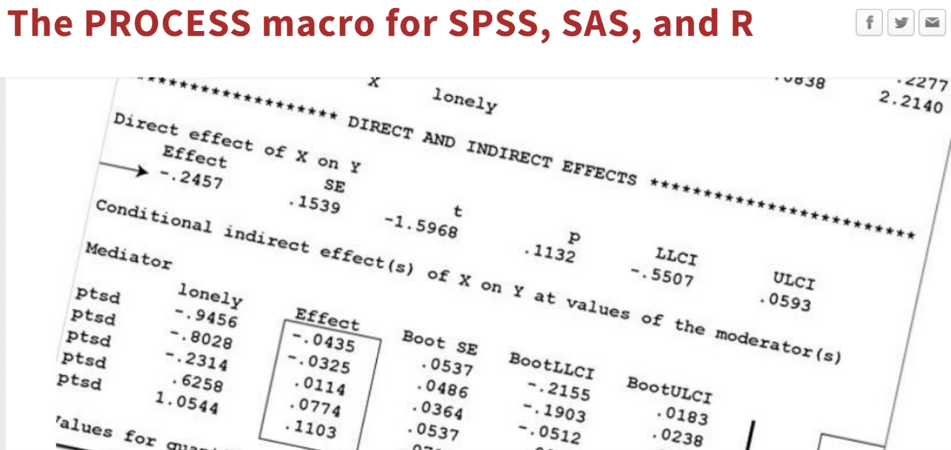
Statistical mediation

Slide 29
Notes:
Who has used PROCESS before? Heard of PROCESS?

Slide 30
The research program of statistical mediation
Correct standard errors
Latent variable modeling
Extension of mediation model to more variables, larger models, broader contexts

Slide 31
The (gaps in the) research program of statistical mediation
Causal assumptions
Causal identification / Causal definitions of effects
Non-linear models (interactive, limited dependent variables, etc.)

Slide 32
Statistical mediation

Slide 33
Tracing rules
Wright (1934) developed rules that allow one to “read off” covariances from a path diagram
From these covariances one can derive arbitrary regression coefficients for any regression model of interest (using the recursive formula)

Slide 34

Statistical mediation
Covariance X and M
X -> M (a)
Covariance M and Y
M -> Y (b)
M <- X -> Y (ac’)
Covariance X and Y
X -> Y (c’)
X -> M -> Y (ab)

Slide 35
Statistical mediation
 | X | M | Y
X | 1
M | a | 1
Y | ab+c’ | b + ac’ | 1

Slide 36
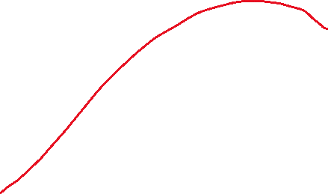

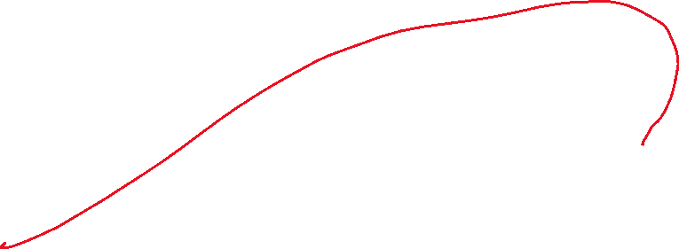
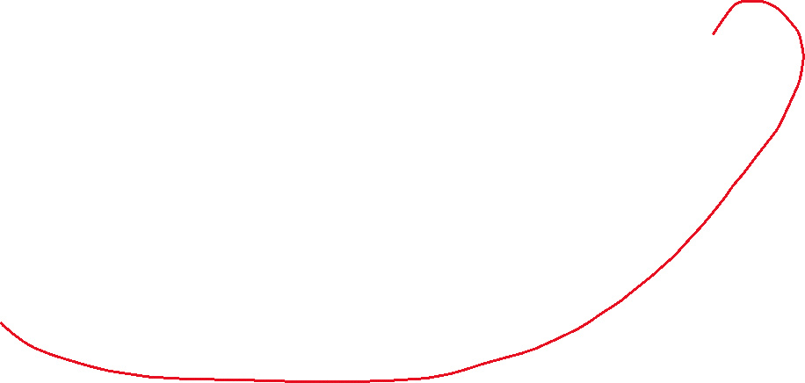
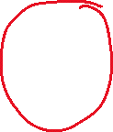
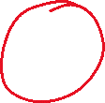

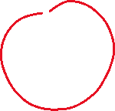
Statistical mediation
 | X | M | Y
X | 1
M | a | 1
Y | ab+c’ | b + ac’ | 1
$$β_{XM}=a \\ β_{XY}=ab+c′$$
$$β_{MY|X}=\frac{b+ac^{′}−a×(ab+c^{′}) }{{1−a}^{2}}=\frac{b+ac^{′}−a^{2}b−{ac}^{′} }{{1−a}^{2}} \\ =\frac{b−a^{2}b }{{1−a}^{2}} \\ =\frac{b(1−a^{2}\text{)} }{{1−a}^{2}} \\ =b$$
Notes:
Recursive formula:
Beta yx|z = ρyx - ρyz * ρzx / (1 – ρ^2 xz)

Slide 37


Statistical mediation
 | X | M | Y
X | 1
M | a | 1
Y | ab+c’ | b + ac’ | 1
$$β_{XM}=a \\ β_{XY}=ab+c^{′} \\ β_{MY|X}=b$$
$$β_{XY|M}=\frac{ab+c^{′}−a×(b+ac^{′}) }{1−a^{2}} \\ =\frac{ab+c^{′}−ab−{a^{2}c}^{′} }{1−a^{2}} \\ =\frac{c^{′}−{a^{2}c}^{′} }{1−a^{2}} \\ =\frac{c^{′}(1−a^{2})}{1−a^{2}} \\ =c′$$
Notes:
Recursive formula:
Beta yx|z = ρyx - ρyz * ρzx / (1 – ρ^2 xz)

Slide 38


Statistical mediation
Individual effects
$β_{XM}=a$
$β_{XY}=ab+c^{′}$= c $β_{MY|X}=b$ $β_{XY|M}$= c’ (direct effect)
 | X | M | Y
X | 1
M | a | 1
Y | ab+c’ | b + ac’ | 1
Mediated (indirect) effects
$$β_{XM}×β_{MY|X}=ab \\ β_{XY}−β_{XY|M}=\left(ab+c^{′}\right)−c^{′}=c−c^{′}= ab$$
Notes:
Recursive formula:
Beta yx|z = ρyx - ρyz * ρzx / (1 – ρ^2 xz)

Slide 39
Statistical mediation
The model above can also be extended to include an interaction between X and M
While this is not often done (and tested for) in applied settings, it is a well-established fact of this statistical model

Slide 40
Statistical mediation
$Y=β_{0}+β_{1}X$
$Y=β_{0}+β_{1}X+β_{2}M+β_{3}X:M$
$$M=β_{0}+β_{1}X$$

Slide 41






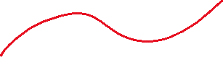
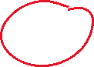

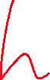


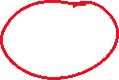

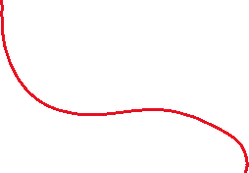
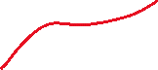
Statistical mediation
$Y=β_{0}+β_{1}X$
$Y=β_{0}+β_{1}X+β_{2}M+β_{3}X:M$
$$M=β_{0}+β_{1}X$$

Slide 42


Statistical mediation
$Y=β_{01Y}+cX$
$Y=β_{02Y}+c′X+bM+hX:M$
$$M=β_{01M}+aX$$

Slide 43


Statistical mediation
Individual effects
$β_{XM}=a$
$β_{MY|X0}=b_{X0} (simple b path when X=0)$
$β_{MY|X1}=b_{X0}+h \left(simple b path when X=1\right)$
$β_{XY|M0}$= c’ (simple direct effect when M = 0)
$β_{XY|M0}$= c’ +h (simple direct effect when M = 1)
Mediated (indirect) effects
$β_{X0M}×β_{MY|X0}=ab_{X0}$ (simple mediated effect when X=0)
$β_{X1M}×β_{MY|X1}=a\left(b_{X0}+h\right)=ah+ab_{X0}$ (simple mediated effect when X=1)

Slide 44

Statistical mediation
Direct effects
$β_{XY|MX0}$= c’ +h M_{X0} (simple direct effect when M = mean of M when X = 0)
$β_{XY|MX1}$= c’ + h M_{X1} = c’ + h M_{X0} + ah (simple direct effect when M = mean of M when X = 1)
Differences between the simple direct effects and the total effect (c) would also yield estimates of the indirect effect

Slide 45
Statistical mediation
In actual data analysis these effects are usually computed from raw data using either linear regressions or structural equation model (SEM)
SEM allows for estimation of a set of equations simultaneously

Slide 46


Slide 47
Statistical mediation
Full reproducible code on github
example1.R

Slide 49
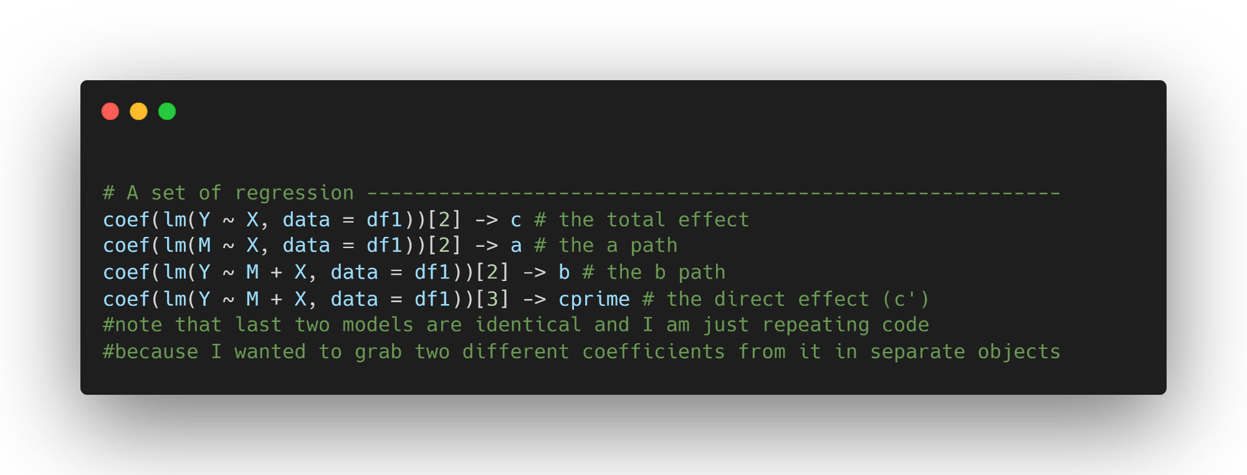
Statistical mediation

Slide 50
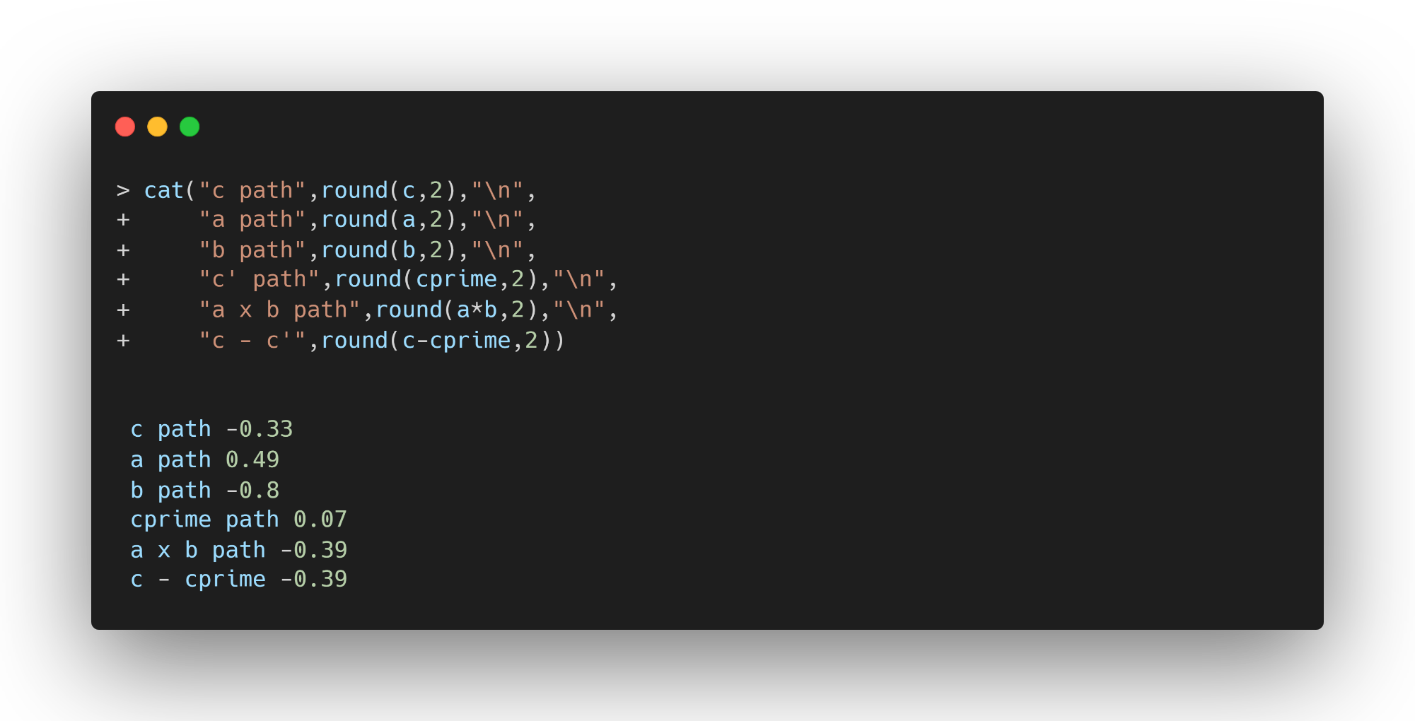
Statistical mediation

Slide 51
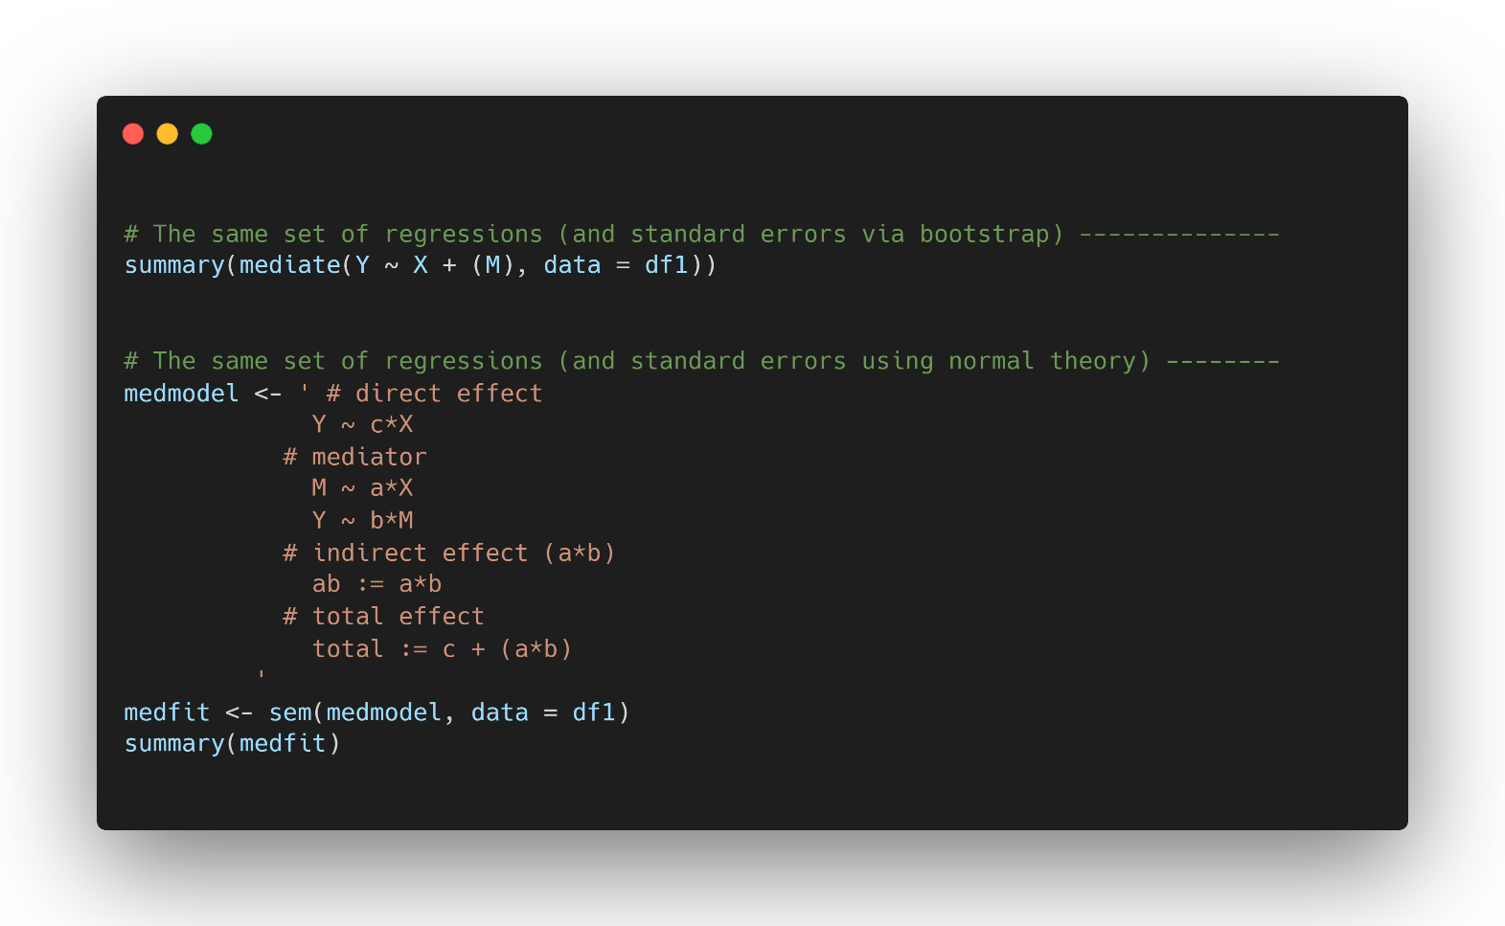
Statistical mediation

Slide 52
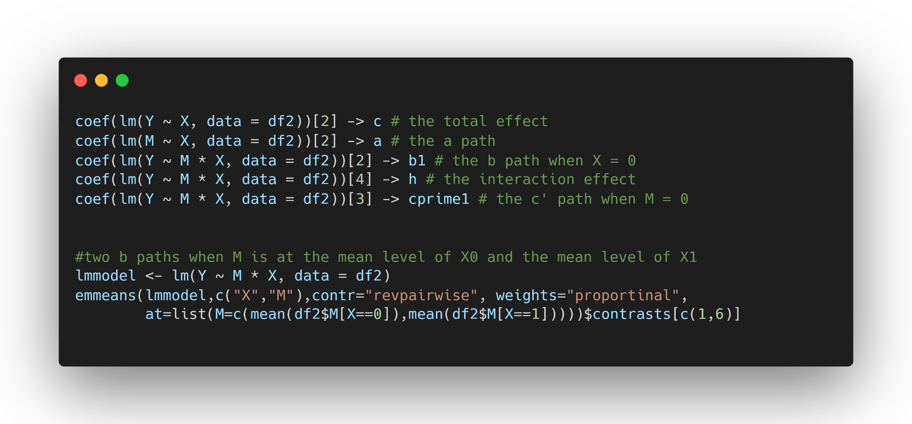
Statistical mediation

Slide 53
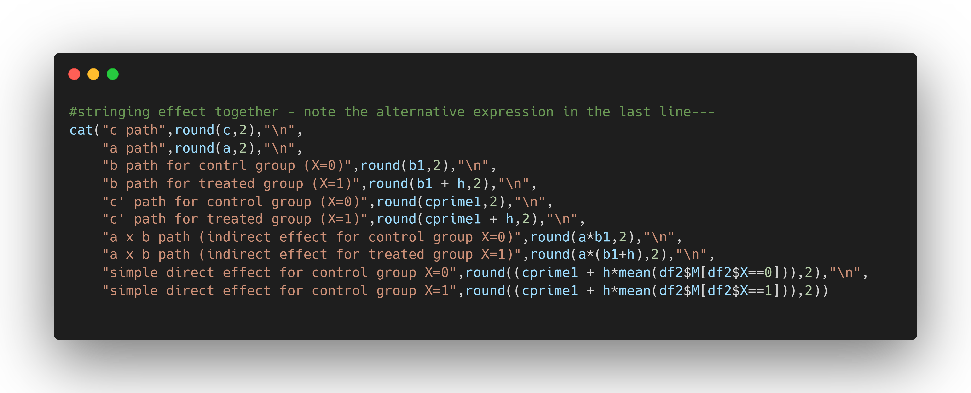
Statistical mediation

Slide 54
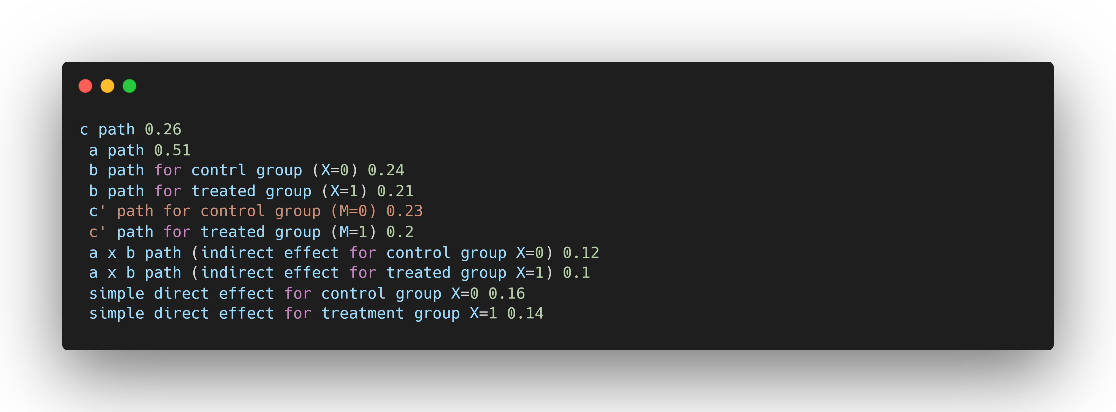

Slide 55

image: Flaticon.com

Slide 56
Statistical mediation exercise
Download data “exercise1.csv” directly from github
It contains the following three variables
Participation in drug education program (program, 0 = no, 1 = yes)
Knowledge about drugs - score (knowledge, 0-10)
Susceptibility to abuse drugs - score (suspect, 0-10)
Perform a statistical mediation analysis and report the total effect of the program on susceptibility and knowledge, the direct and the indirect effect of the same variables, and the component paths of the mediation model

Slide 57


Slide 58
Building blocks

Slide 59
Causal mediation building blocks
Potential outcomes notation
Causal DAGs (directed acyclic graphs)

Slide 60
Potential outcomes

Slide 61
Notes:
Who used / heard of potential outcomes before?

Slide 62


TREATMENT
$$τ_{i} = {\text{Y}}_{\text{i}\text{1}}\text{ − }{\text{Y}}_{\text{i}\text{0}}$$
Unit –level Causal Effect
CONTROL

Slide 63


TREATMENT
$$τ=\frac{1}{n}\sum_{i=1}^{n}{Y_{i1}}−\frac{1}{n}\sum_{i=1}^{n}{Y_{i0}}$$
CONTROL
Average Causal Effect

Slide 64

TREATMENT
$$τ∗=\frac{1}{n}\sum_{i=1}^{n}{(Y_{i1}|Z1})−\frac{1}{n}\sum_{i=1}^{n}{(Y_{i0}|Z0})$$
CONTROL
Estimate of the Average Causal Effect

Slide 65


CONTROL
TREATMENT
CONTROL
TREATMENT
E(Y_{i1}) = E(Y_{i1} | z_{i} = 1)
E(Y_{i0}) = E(Y_{i0} | z_{i} = 0)
E(Y_{i1}) ≠ E(Y_{i1} | z_{i} = 1)
E(Y_{i0}) ≠ E(Y_{i0} | z_{i} = 0)

Slide 66
E(Y_{i1}) = E(Y_{i1} | z_{i} = 1) Randomized experiment
E(Y_{i0}) = E(Y_{i0} | z_{i} = 0)
E(Y_{i1}) ≠ E(Y_{i1} | z_{i} = 1) Non-randomized E(Y_{i0}) ≠ E(Y_{i0} | z_{i} = 0) experiment
E(Y_{i1}) = E_{x}{E(Y_{i1} | z_{i} = 1, x)} Non-randomized E(Y_{i0}) = E_{x}{E(Y_{i0} | z_{i} = 0, x)} experiment with unconfoundedness assumption
X contains all confounding covariates

Slide 67
Randomization
Randomized experiments are considered “gold standard” for causal inference
Randomization balances all observed and unobserved variables and (by expectation) rules out alternative explanations
An intuitive explanation is that under randomization, comparable groups are formed, and hence the only difference between these groups is the treatment status
Observed group differences must therefore be due to the treatment
Notes:
The randomized controlled trial has been called the gold standard for causal inference, because a randomized experiment has desirable properties to infer causal relationships from observed associations.
A properly conducted randomized experiment allows for causal claims.
Now, we cannot always randomized treatments, but there still phenomena that we are interested in and that we would like to study. Does that mean that we are unable or even should not study a phenomenon because we can’t randomize? No – but we have to be careful about the implications of non-randomization.
Here are a few examples of instances where we can’t randomize:
Trials where treatment is offered to community at large – for example a social justice oriented program that is offered to everybody who needs it, and maybe our main interest is to help the community, but we still might be interested in evaluating the effectiveness of the program
Stakeholders do not permit randomization – I live in Arizona and we currently have a lot of TV ads warning people about the dangers of using methemphatimes. The people from Montana who fund this study are mainly interested in putting these ads on TV, but they don’t want to randomize this (granted, it would be very hard to do).
Ethical or legal considerations
Naturally occurring phenomena – you obviously can’t randomly assign cities to be hit by Hurricane Katrina, but there are numerous studies out there that tried to assess effects on hurricane victims
Broken randomized experiments – Even if you randomize a treatment, as soon as you leave the confinement of a laboratory the randomization can break down. Attrition, or even differential attrition can occur, non-compliance (meaning people don’t do what they are supposed to do under the treatment) can occur, or treatments can diffuse to the control group. This is an important category, because just because you randomize a treatment does not mean that everything will work out that way.
As a consultant at the ASU School of Social Work I worked with a colleague that randomized a treatment for immigrant families , but the randomization occurred at the treatment delivery site. Upon inspecting the data it became clear that the treatment administrators actually gave the treatment more often to families that were in greater need.

Slide 68
Randomization
Few assumptions
Compliance
No missing data
No hidden treatment variations
Independence of units (assignment of one unit does not influence outomce of another unit)

Slide 69
Randomization
Randomization not always possible
Trials where treatment is offered to community at large
Participants do not permit randomization
Ethical or legal considerations
Naturally occurring phenomena
Broken randomized experiments (attrition, non-compliance, treatment diffusion)

Slide 70
Non-randomized trial
Lack of randomization can create imbalance PRIOR to treatment assignment
Confounding occurs due to imbalance and relationship with outcome
Bias can be corrected, but all confounders must be assessed → no unique influence of confounder can be left out for unbiased effect estimate

Slide 71
Causal inference
Randomization ensures identification of the causal effect of the randomized variable
If a randomized experiments (in which the mentioned assumptions are met) yields a treatment effect, then the only alternative explanation is chance
Quantify this chance (and to limit it) is a goal of inferential statistics

Slide 72
Randomization in mediation
Only X can be randomized in a single experiment
Randomizing X and M is a factorial experiment, and naturally the effect of X on M (and thus the indirect effect) cannot be estimated in such a design
In the typical randomized trial in which X is randomized, the M – Y relationship is still purely observational and thus subject to confounding bias

Slide 73
Potential outcomes
Full reproducible code on github
example2.R

Slide 74
X | Y₀ | Y₁ | Y | Y₁ - Y₀ | Y|X=0 | Y|X=1
1 | 13 | 15 | 15 | 2 |  | 15
1 | 9 | 10 | 10 | 1 |  | 10
1 | 11 | 15 | 15 | 4 |  | 15
1 | 12 | 13 | 13 | 1 |  | 13
1 | 10 | 9 | 9 | -1 |  | 9
1 | 10 | 12 | 12 | 2 |  | 12
1 | 10 | 11 | 11 | 1 |  | 11
0 | 12 | 18 | 12 | 6 | 12
1 | 11 | 10 | 10 | -1 |  | 10
0 | 10 | 11 | 10 | 1 | 10
0 | 12 | 17 | 12 | 5 | 12
1 | 10 | 11 | 11 | 1 |  | 11
0 | 10 | 12 | 10 | 2 | 10
1 | 12 | 14 | 14 | 2 |  | 14
0 | 8 | 15 | 8 | 7 | 8
0 | 10 | 11 | 10 | 1 | 10
1 | 13 | 15 | 15 | 2 |  | 13
 | 10.625 | 12.75 |  | 2.125 | 10.3 | 12
Average of true individual causal effects
2.125
Estimate of true average causal effect based on randomized X
1.66
Somewhat close and will in expectation converge to truth

Slide 75
X_nr | Y₀ | Y₁ | Y_nr | Y₁ - Y₀ | Y|X=0 | Y|X=1
1 | 13 | 15 | 15 | 2 | 15
1 | 9 | 10 | 10 | 1 |  | 10
0 | 11 | 15 | 11 | 4 |  | 11
0 | 12 | 13 | 12 | 1 |  | 12
1 | 10 | 9 | 9 | -1 | 9
0 | 10 | 12 | 10 | 2 |  | 10
1 | 10 | 11 | 11 | 1 | 11
0 | 12 | 18 | 12 | 6 |  | 12
1 | 11 | 10 | 10 | -1 | 10
0 | 10 | 11 | 10 | 1 |  | 10
0 | 12 | 17 | 12 | 5 |  | 12
1 | 10 | 11 | 11 | 1 | 11
0 | 10 | 12 | 10 | 2
0 | 12 | 14 | 12 | 2 |  | 12
1 | 8 | 15 | 15 | 7 | 15
1 | 10 | 11 | 11 | 1 | 11
1 | 13 | 15 | 15 | 2 | 15
 | 10.625 | 12.75 |  | 2.125 | 11.1 | 11.5
Average of true individual causal effects
2.125
Estimate of true average causal effect based on non-randomized X
0.375
Far from truth and will not in expectation converge to truth

Slide 76
X_nr | Y₀ | Y₁ | Y_nr | Y₁ - Y₀ | Z | Y|X=0, Z = 0 | Y|X=0, Z = 1 | Y|X=1, Z = 0 | Y|X=1, Z = 1
1 | 13 | 15 | 15 | 2 | 1 |  |  |  | 15
1 | 9 | 10 | 10 | 1 | 0 |  |  | 10
0 | 11 | 15 | 11 | 4 | 1 |  | 11
0 | 12 | 13 | 12 | 1 | 1 |  | 12
1 | 10 | 9 | 9 | -1 | 0 |  |  | 9
0 | 10 | 12 | 10 | 2 | 0 | 10
1 | 10 | 11 | 11 | 1 | 0 |  |  | 11
0 | 12 | 18 | 12 | 6 | 1 |  | 12
1 | 11 | 10 | 10 | -1 | 0 |  |  | 10
0 | 10 | 11 | 10 | 1 | 0 | 10
0 | 12 | 17 | 12 | 5 | 1 |  | 12
1 | 10 | 11 | 11 | 1 | 0 |  |  | 11
0 | 10 | 12 | 10 | 2 | 0 | 10
0 | 12 | 14 | 12 | 2 | 1 |  | 12
1 | 8 | 15 | 15 | 7 | 0 |  |  | 15
1 | 10 | 11 | 11 | 1 | 0 |  |  | 11
 | 10.625 | 12.75 |  | 2.125 |  | 10 | 11.8 | 11 | 15
Average of true individual causal effects
2.125
Estimate of true average causal effect based on non-randomized X and conditioning on Z [11*P(Z=0) + 15*P(Z=1)] – [10*P(Z=0) + 11.8*P(Z=1)] = [11*.625 + 15*.375] – [10*.625 + 11.8*.375] = 12.5 - 10.675 = 1.825
Closer to truth and will in expectation converge to truth if Z is only confounder

Slide 78
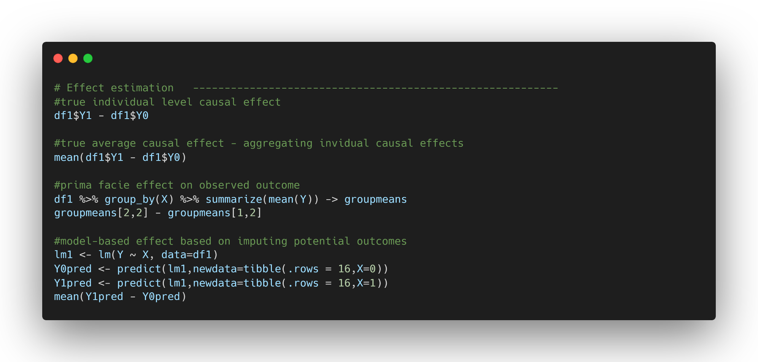

Slide 79
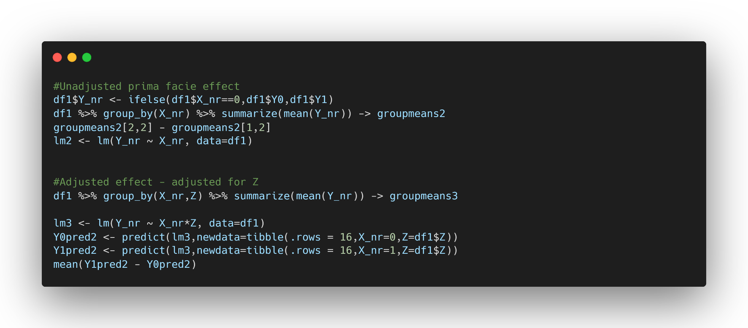

Slide 80
image: Flaticon.com

Slide 81
Potential outcome exercise
Download data “exercise2.csv” directly from github
It contains a dataframe with the following variables
X - a treatment assignment with three levels (0, 1, 2)
Z – a covariate with three levels (0,1,2)
Y₀, Y₁, Y₂ – three potential outcomes for each level of the treatment
Generate the true individual treatment effects for each person, comparing all three levels of treatment with each other

Slide 82
Potential outcome exercise
Compute prima facie, unadjusted treatment effects for all comparisons of treatment levels
Run a model with Z as a covariate, and generate model-implied potential outcomes Y₀_mo, Y₁_mo, Y₂_mo, and compute from those, treatment effects for all combinations of potential outcomes

Slide 84
Directed acyclic graphs (DAGs)

Slide 85
Notes:
Who has heard / used DAGs before?

Slide 86
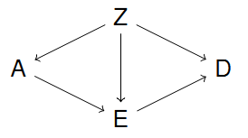
Graphical “language”
Letters in graphs are variables and often referred to as nodes or vertices
Connections between nodes are referred to as arrows or edges

Slide 87
Graphical “language”
Relationships between nodes
Z is parent of A, D, E
D is a child of Z and E
D is a descendant of A
A is an ancestor of D

Slide 88
Graphical “language”
Nodes with arrows (directly) emanating into other nodes are referred to as parents (or ancestors)
Nodes with arrows pointing (directly) into them are children (or descendants)

Slide 89
Graphical “language”
A connection via several arrows is referred to as a path (or trail)
A path can have arrows going into different directions, e.g., A ← Z → E → D

Slide 90
Causal model
A directed arrow between two nodes represents an assumed causal effect between two variables
This effect may be linear, non-linear, deterministic – completely non-parametric

Slide 91
Causal model
A bi-directed arrow between two nodes represents an unobserved cause
We may either draw a latent variable with directed paths or use bi-directed arrows

Slide 92
Causal model
The absence of an arrow between two variables denotes the absence of any direct effect or latent confounding
It is the absence of arrows that is most critical and that must be argued for

Slide 93
Causal model
There might be strong disagreement about how the DAG should look like
However, once researchers agree on the structure of the DAG, there should also be agreement about which effects can be causally interpreted, and which model should be used to estimate these effects

Slide 94
Causal model
DAGs put our theoretical assumptions about the relationships between variables of interest in a graphical format
DAGs as a manifestation of your literature review and best-known theory
DAGs are helpful to formalize theory and formalize what to adjust on

Slide 95
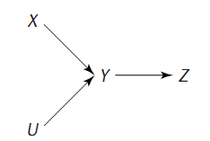
Causal model
What kind of assumptions are advertised in the following DAG?
Credit: M. Glymour

Slide 96
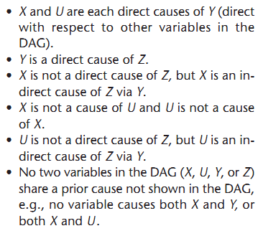
Credit: M. Glymour

Slide 97
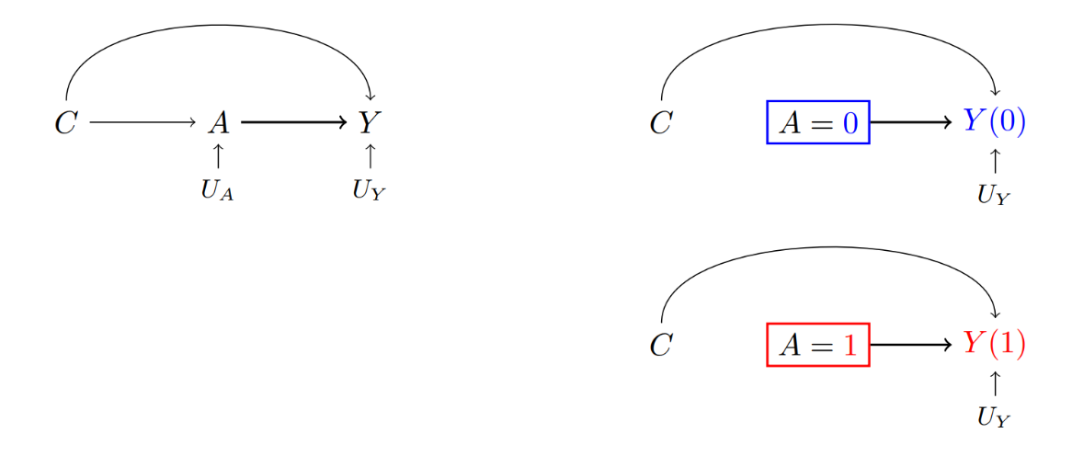
Connection of DAGs and POs
X
X
X
Credit: Nguyen, Schmid, & Stuart, Psych Methods, 2020

Slide 98
Causal model
DAGS allow us to check whether a causal effect is identified (meaning can be estimated from data)
The back-door criterion relies on a concept called d-separation and the idea of “blocking” paths that would otherwise induce bias

Slide 99
Causal model
The back-door criterion tells a researcher what variables need to be adjusted on (e.g., through regression or matching) in order to obtain an unbiased causal effects
It can be applied manually or through dagitty (or other software and R packages)

Slide 100
Type of paths
We define a path that has an arrow going out of the treatment variable, as a front-door path
We define a path that has an arrow going into the treatment variable, as a back-door path
We define a path that is not blocked, as open
We define a path that is blocked, as closed
All four combinations of paths can exist

Slide 101
Type of paths
Front-door + open → causal path
Front-door + closed → neutral, but biasing (for total effect) if opened
Back-door + open → biasing path
Back-door + closed → neutral, but biasing if opened

Slide 102
Blocking a path
Blocking refers to holding a variable constant in a graph
In practice, this may mean regression adjustment, or other techniques
Whether or not a variable blocks a particular path is dependent on other variables in the path, and the direction of the arrows

Slide 103
Blocking a path
Common cause (fork)
Mediation (chain)
Mediation (inverted chain)
Collider (inverted fork)

Slide 104
Back-door
Check all paths from your supposed cause X (treatment) to outcome
Block all biasing paths, without blocking any causal paths, or opening any closed front-door paths (leave all front-door paths as they were)
Note that in this process of blocking we might open previously closed back-door paths which could turn into biasing paths, which we will need to close as well

Slide 105
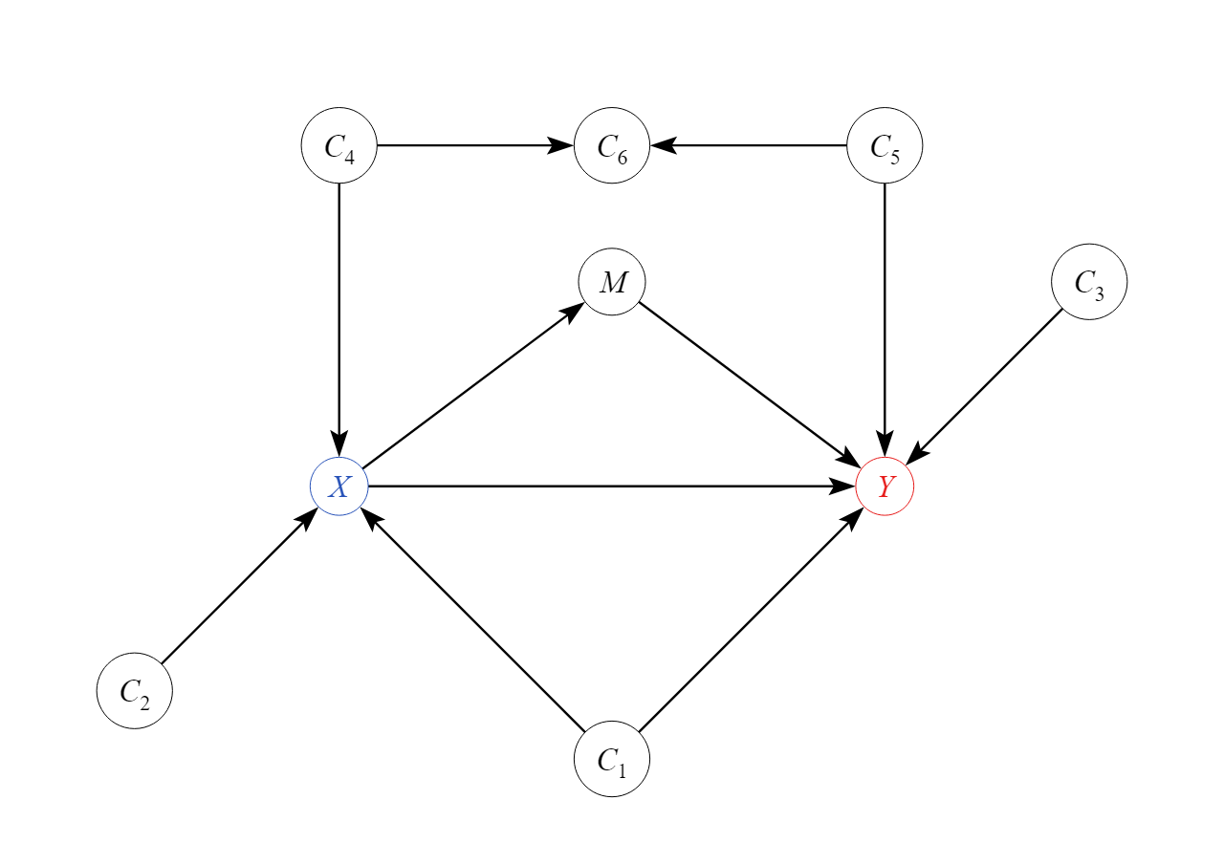

Slide 106
Paths
X -> M -> Y
X <- C1 -> Y
X <- C4 -> C6 <- C5 -> Y

Slide 107
Paths
X -> M -> Y Open front-door path
X <- C1 -> Y Open back-door path
X <- C4 -> C6 <- C5 -> Y Closed back-door path

Slide 108
DAG software
Drawing DAGs is often easier using a graphical user interface
dagitty.net (Johannes Textor)
causalfusion.net (Elias Barenboim)
Tetrad (Carnegie Mellon group)
We will use the dagitty R package

Slide 110
DAGs
Full reproducible code on github
example3.R

Slide 111
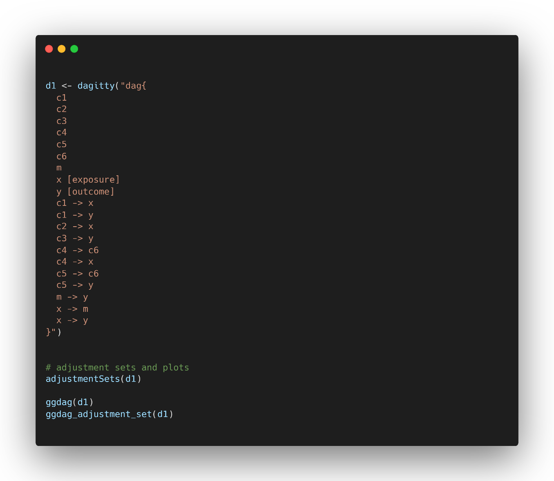

Slide 112
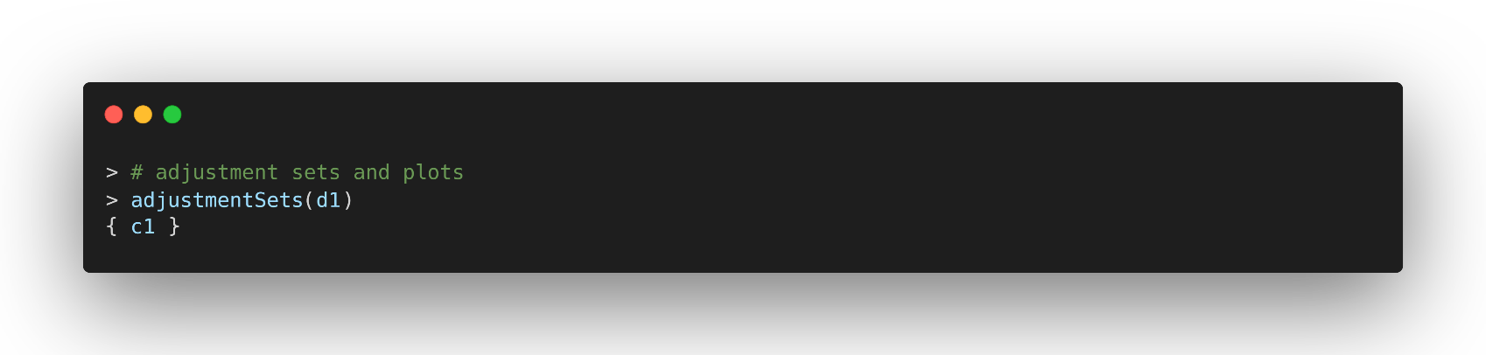
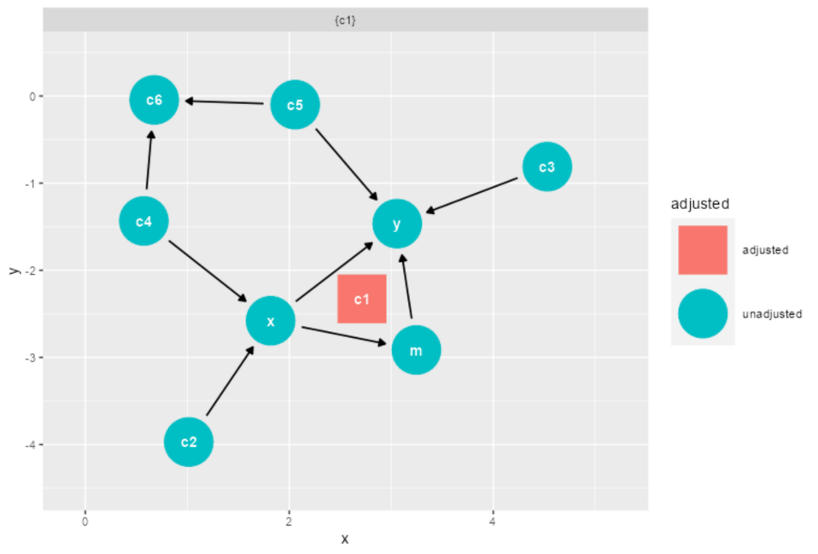

Slide 113
image: Flaticon.com

Slide 114
DAG exercise
Download “exercise3.R” directly from github
Using daggity, define the DAG on the next slide
Find an adjustment set for the total effect from X to Y
Enumerate all paths from X to Y, and then from V to W
Try to replicate the results from dagitty by hand

Slide 115
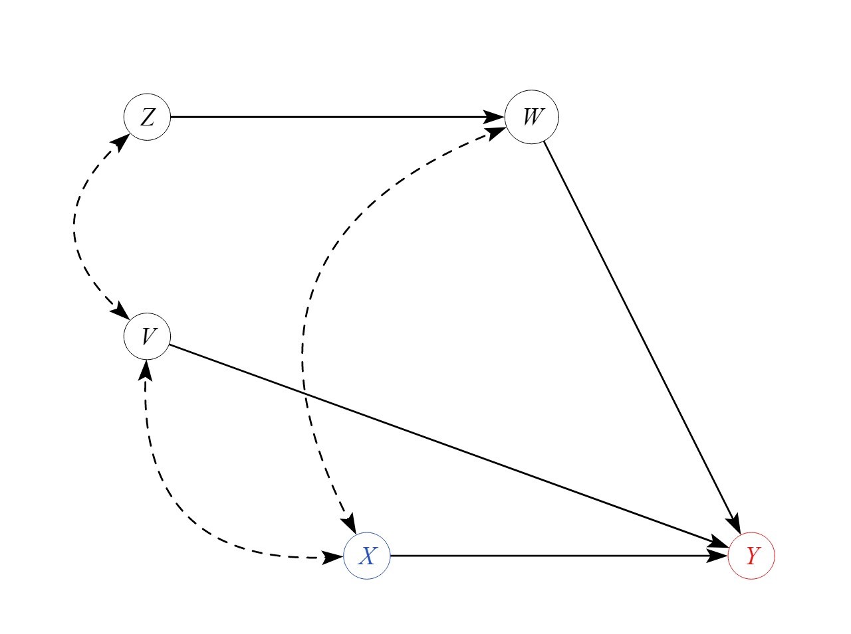

Slide 116
Notes:
Do the back-door criterion on the next slid

Slide 117
DAGs
In addition to finding adjustment sets, DAGs can also be helpful to find equivalent models
The so-called Markov equivalence class contains all sets of models that are indistinguishable by statistical procedures
Concretely that means that every time a researcher claims that the model is supported by the data, there are actually alternative models that are equally supported by the data alone

Slide 118
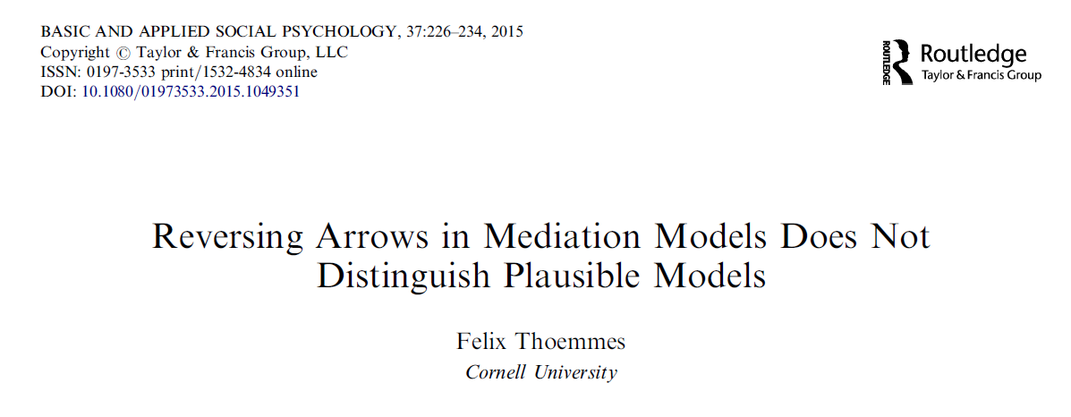

Slide 119
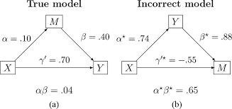
Reversing arrows

Slide 120
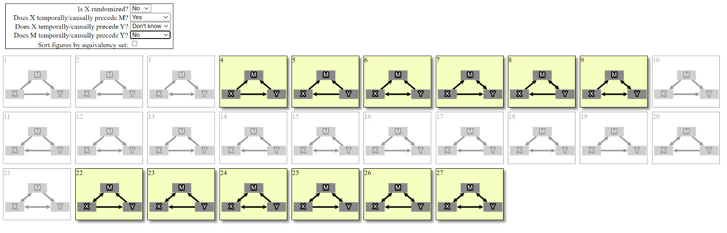

Slide 121
Causal mediation building blocks
Potential outcomes notation will allow us to formally define the causal estimands (the causal quantities of interest)
DAGs will help us to display and understand the necessary assumptions that are needed to estimate the causal estimands without bias

Slide 122
Causal mediation estimands

Slide 123
Causal mediation
Will causal mediation analysis simply be a new analysis technique that makes my estimates causal?
Has statistical mediation analysis now become invalid with the advent of causal mediation techniques?

Slide 124
Causal mediation
Causal mediation analysis focuses on rigorously defining
Causal effects of interest
Assumptions needed for estimates to be interpreted casually
Statistical mediation and (some) causal mediation model will yield IDENTICAL results

Slide 125
Mediation model

Slide 126
Mediation model
To make this a bit more tangible I will use a modified example from @EpiEllie (Twitter / X handle of Eleanor Murray)
X is whether a sailor does or does not eat lemons (0,1)
M is an indicator of whether sufficient Vitamin C is present in the body – maybe through a test which results in a positive or negative (0,1)
Y is scurvy remediation where low scores indicate worse outcomes, and higher scores indicate better outcomes

Slide 127
Potential outcomes in mediation
X | M | Y | M₀ | M₁ | Y₀₀ | Y₀₁ | Y₁₀ | Y₁₁ | Y_{0M0} | Y_{0M1} | Y_{1M0} | Y_{1M1}
0 | 0 | 5 | 0 | 0 | 5 | 6 | 7 | 7 | 5 | 5 | 7 | 7
0 | 0 | 3 | 0 | 1 | 3 | 8 | 4 | 4 | 3 | 8 | 4 | 4
0 | 0 | 4 | 0 | 1 | 4 | 7 | 7 | 4 | 4 | 7 | 7 | 4
0 | 1 | 6 | 1 | 1 | 2 | 6 | 7 | 8 | 6 | 6 | 8 | 8
1 | 0 | 6 | 0 | 0 | 3 | 4 | 6 | 6 | 3 | 3 | 6 | 6
1 | 1 | 8 | 1 | 0 | 2 | 0 | 2 | 8 | 0 | 2 | 8 | 2
1 | 1 | 7 | 1 | 1 | 3 | 1 | 5 | 7 | 1 | 1 | 7 | 7
1 | 1 | 9 | 0 | 1 | 4 | 5 | 6 | 9 | 4 | 5 | 6 | 9

Slide 128
Potential outcomes in mediation
M₀ and M₁ are “easy” potential outcomes that we have seen before
They denote the value that the mediator M would have taken on if the treatment X would have been set to either “0” or “1”, e.g., treatment and control
M₀ is the potential outcome on the mediator if the sailor does not eat lemons (0), M₁ is the potential outcome on the mediator if the sailor eats lemons (1)

Slide 129
Potential outcomes in mediation
M₀ is the potential outcome on the vitamin C indicator for the non-lemon eating sailor
M₁ is the potential outcome on the vitamin C indicator for the lemon-eating sailor
One of these two potential outcomes will be observed once we run the experiment, and the other one will be the missing counterfactual

Slide 130
Potential outcomes in mediation
Y₀₀, and the other potential outcomes of Y are a bit more challenging to describe
Y₀₀ is the potential outcome if both X and M are set to “0”
Likewise Y₀₁, Y₁₀, and Y₁₁ are potential outcomes of other respective combinations of setting X and M at certain levels
Only one (!) of these four potential outcomes is observed

Slide 131
Potential outcomes in mediation
The important feature of these potential outcomes is that both X and M are forced to take on certain values
Consider a joint intervention that sets these variable to certain values
Sometimes this may seem a bit counter-intuitive, e.g., Y₀₁ setting the sailor to not eat lemons, but his vitamin C is not deficient

Slide 132
Potential outcomes in mediation
Y₀₀ is the potential outcome on the scurvy remediation for a sailor whose status is set to not eat lemons, and to have a vitamin C deficiency
Y₀₁ is the potential outcome on the scurvy remediation for a sailor whose status is set to not eat lemons, and to have no vitamin C deficiency
Y₁₀ is the potential outcome on the scurvy remediation for a sailor whose status is set to eat lemons, and to have a vitamin C deficiency
Y₁₁ is the potential outcome on the scurvy remediation for a sailor whose status is set to eat lemons, and to have no a vitamin C deficiency

Slide 133
Potential outcomes in mediation
There are even more potential outcomes – sometimes referred to as composite outcomes or nested counterfactuals
Y_{0M0} is the potential outcome on the scurvy remediation when treatment is set to “0”, and the mediator takes on the value that it would take on when treatment is set to “0”
A sailor who is set to not eat lemons, and the vitamin C deficiency is set to the value that it would be if the sailor would not eat lemons
Note that this is different for each participant, based on their potential outcomes for M₀ and M₁ for some sailors Y_{0M0} becomes Y₀₀ for others Y₀₁

Slide 134
Potential outcomes in mediation
Y_{0M1} is the outcome for a sailor whose status is set to not eat lemons, but the vitamin C deficiency is set to the level that would have been achieved if the sailor would have eaten lemons
This is sometimes referred to as a cross-world counterfactual
For every sailor, this could resolve to Y₀₀, or Y₀₁

Slide 135
Notes:
Who has heard of cross-world counterfactuals before?

Slide 136
Potential outcomes in mediation
Y_{1M0} and Y_{1M1} are the additional potential outcomes that mirror the two that we just discussed
Y_{1M0} is a cross-world counterfactual and both potential outcomes resolve for each participant to either Y₁₁ or Y₁₀

Slide 137
Notes:
Discuss potential outcomes and what you have learned so far

Slide 138
Potential outcomes
Think about the variety of potential outcomes and what they mean for the following scenario
X = exercise program (30 minutes daily)
M = blood pressure (actual measurement)
Y = Cardiac arrest (“heart attack”) risk

Slide 139
Potential outcomes
Think about the variety of potential outcomes and what they mean for the following scenario
X = Gender (Male vs Female)
M = Type of degree (STEM vs non-STEM)
Y = Salary

Slide 140
Causal estimands
With all of these potential outcomes in hand, we can now define a variety of effects

Slide 141
Causal estimands
Effect of treatment X on mediator M
M₁ – M₀ for each unit i
Summing over these differences gives average causal effect
E(M₁ – M₀)

Slide 142
Causal estimands
The effect of eating or not eating lemons on the measurement of vitamin C deficiency (deficient vs. not deficient)

Slide 143

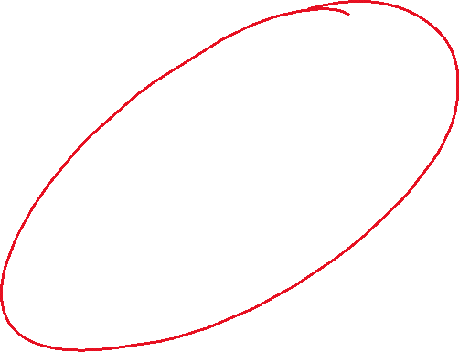
Causal mediation

Slide 144
Causal estimands
Effect of treatment X on outcome Y while holding mediator M constant at some specified value m (e.g., 0 and 1)
Controlled direct effect (CDE)
Y₁₁ – Y₀₁ for each unit i
Summing over these differences gives average controlled direct effect
E(Y₁₁ – Y₀₁ ) CDE(1)

Slide 145
Causal estimands
Effect of treatment X on outcome Y while holding mediator M constant at some specified value m (e.g., 0 and 1)
Controlled direct effect (CDE)
Y₁₀ – Y₀₀ for each unit i
Summing over these differences gives average controlled direct effect
E(Y₁₀ – Y₀₀ ) CDE(0)

Slide 146
Causal estimands
In the absence of an X-M interaction (effect of X on Y differs as a function of M), the CDE(1) and CDE(0) are identical
In models with interactions, we may report both CDE(1) and CDE(0), or report an average of the two
Note that averages in the presences of (large) interactions can obscure the fact that differential effects exist

Slide 147
Causal estimands
In our example, M only had two values, 0,1
In cases in which M takes on many values there are just as many more controlled direct effects (CDE)
With continuous variables, there are theoretically an infinite amount of CDEs – all holding M constant at a different value

Slide 148
Causal estimands
Unclear at which value M should be held to evaluate the direct effect of X on Y
Every value of M will yield a different controlled direct effect
CDE also holds M constant at values that are differentially achieved for treated and untreated individuals
No controlled version of indirect (CIE) effect because there is no way of disabling the direct effect of X on Y by setting a variable to a constant

Slide 149
Causal estimands
The effect of eating or not eating lemons on scurvy while holding the measurement of vitamin C deficiency constant at either having or not having vitamin C deficiency
Logically, because we are holding the mediator constant, any difference in the outcome must be due to something else in X that is not transmitted through the mediator
That could be other unmeasured mediators or direct effects of X itself

Slide 150
Causal estimands
We force everyone to either eat lemons or not eat lemons, then we somehow force the vitamin C levels to be exactly the same, and then we observe the outcome of scurvy remediation
Differences between the groups cannot be due to vitamin C (since we forced this to be identical for all participants)
Effects of eating lemons on scurvy cannot be transmitted via vitamin C – maybe they are due to some other compounds in lemons

Slide 151


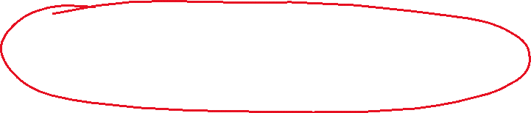
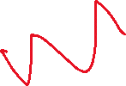

Causal mediation

Slide 152
Notes:
Who has heard of the NATURAL DIRECT EFFET / NATURAL INDIRECT EFFECT / PURE DIRECT AND DIRECT EFFECT?

Slide 153
Causal estimands
Effect of treatment X on outcome Y while holding mediator M constant at the value that it would have achieved under the control condition
Natural direct effect (NDE)
Y_{1M0} – Y_{0M0} for each unit i
Summing over these differences gives average natural direct effect
E(Y_{1M0} – Y_{0M0} ) Average NDE (ANDE)

Slide 154
Causal estimands
There is only one NDE, because there is only one potential outcome for M₀
Note that one of the nested counterfactuals is cross-worlds Y_{1M0}
In our example it is the potential outcome for a sailor that is assigned to eat lemons but whose vitamin C deficiency is set to the level that it would have been if actually assigned to not eat lemons

Slide 155
Causal estimands
The NDE thus asks what the remediation of scurvy would be if we compare people who we force to eat or not eat lemons and then force / set each sailor to have the vitamin C deficiency they would have if they did not eat lemons
Because the mediator M is fixed for each person it also cannot logically exert any influence on the outcome – but instead of fixing it at a single observed value for all, it is fixed at the potential outcome for M₀ that would have been observed in each individual

Slide 156
Causal estimands
This is referred to as the natural direct effect because the mediator M is held constant at whichever level it would naturally achieve
Naturally here implies in the absence of an intervention, hence M₀

Slide 157
Causal estimands
The natural direct effect NDE is also referred (by other authors) as the average direct effect for the untreated, or “average direct effect (control)”, or pure direct effect
Note that in trials in which there is no “passive control”, e.g., treatment is gender or race, there is presumably no natural condition

Slide 158
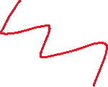
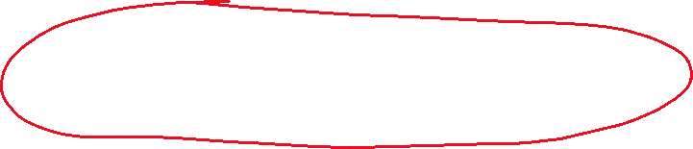



Causal mediation

Slide 159
Causal estimands
In complement to the NDE, we may also define the natural indirect effect (NIE) and its average (ANIE)
Natural indirect effect (NIE)
Y_{0M1} – Y_{0M0} for each unit i
Summing over these differences gives average natural indirect effect
E(Y_{0M1} – Y_{0M0} ) Average NIE (ANIE)

Slide 160
Causal estimands
Again, there is only one NIE, because it is based on comparisons of counterfactual values
Again, note that one of the nested counterfactuals is cross-worlds Y_{0M1}

Slide 161
Causal estimands
The NIE thus asks what the remediation of scurvy would be if we compare people who we force to have the vitamin C deficiency either under treatment (eating lemons) or control (not eating lemons) while we force / set each sailor to not eat lemons
Because the treatment X is fixed for each person it cannot logically exert any influence on the outcome – it is only the value of the mediator that we switch from what it would be under treatment vs what it would be under control

Slide 162
Causal estimands
This is referred to as the natural indirect effect because the treatment X is held constant at the control (or natural) level
Naturally here implies in the absence of an intervention, hence Y₀

Slide 163
Causal estimands
The natural indirect effect NIE is also referred (by other authors) as the average causal mediation effect for the untreated, or “average indirect effect (control)”, or “total indirect effect”

Slide 164







Causal mediation

Slide 165
Causal estimands
The NDE and the NIE are complements in that they pick up on different parts of the total effect
Pearl: “Semantically, NDE measures the portion of the total effect that would be transmitted to Y absent M’s ability to respond to X, while NIE measures the portion transmitted absent Y ’s ability to respond to changes in X, except those transmitted through M.”

Slide 166
Causal estimands
There are additional causal estimands that can be explored
Effect of treatment X on outcome Y while holding mediator M constant at the value that it would have achieved under the treatment condition
Natural direct effect – treated (NDE_1)
Y_{1M1} – Y_{0M1} for each unit i
Summing over these differences gives average total direct effect
E(Y_{1M1} – Y_{0M1} ) Average NDE (ANDE)

Slide 167
Causal estimands
The natural direct effect (treated) is very similar to the natural direct effect, except that it considers the changes from switching X from control to treatment, while holding the mediator M constant at the value that it would have achieved under the treatment condition
In the absence of an X-M interaction, the total direct effect (NED_1) and the pure natural direct effect (NED_0) will be identical

Slide 168
Causal estimands
The “total” label was chosen based on a particular decomposition of the total effect into a pure natural direct effect and a total indirect effect
Other authors (including me) avoid the term total indirect effect because it is confusing that it is a part of the total effect (hence the total label appears twice for different effects)

Slide 169
Causal mediation

Slide 170
Causal estimands
Finally, we can consider an alternative version of the NIE, in which the treatment is held constant at the treated level
Natural indirect effect - treated (NIE)
Y_{1M1} – Y_{1M0} for each unit i
Summing over these differences gives average natural indirect effect
E(Y_{1M1} – Y_{1M0} ) Average NIE (ANIE)

Slide 171
Causal estimands
This is again identical to the NIE with the only exception that the mediator is switched from the potential outcomes with and without treatment, while holding treatment constant at the level of the treated
Without an interaction effect the two versions of the NIE, NIE(0) and NIE(1), or NIE (Control), and NIE (treatment) are identical

Slide 172
Causal mediation

Slide 173
CDE and NDE
CDE_{M=M0} ​= Y_{1M0}-Y_{0M0} = NDE0
CDE_{M=M1} ​= Y_{1M1}-Y_{0M1} = NDE1
This equivalence arises because the NDE inherently fixes M at its natural value under one of the X conditions, which is exactly what we do when we calculate the CDE at the predicted mediator values for those same conditions.
This also implies that we can obtain the natural direct effects by regular regression analysis through evaluation of conditional effects at the means of M under treatment and control

Slide 174
Terminology review
 | Potential outcomes | Pearl | Robins | Imai (mediation)
CDE | Y_{1m} - Y_{0m} | Controlled direct effect | Controlled direct effect | Controlled direct effect
NDE | Y_{1M0} - Y_{0M0} | Natural direct effect | Pure direct effect | Direct effect (control)
TDE | Y_{1M1} - Y_{0M1} |  | Total direct effect | Direct effect (treated)
NIE | Y_{0M1} - Y_{0M0} | Natural indirect effect | Pure indirect effect | Causal mediation effect (control)
TIE | Y_{1M1} - Y_{1M0} |  | Total indirect effect | Causal mediation effect (treated)
TE |  | Total effect | Total effect | Total effect

Slide 175
Causal estimands
And finally, we have the total effect
Simply saying it is Y₁ – Y₀ does not truly align with the rest of the model
After all we defined the potential outcomes of Y to differ by both X and M, hence the total effect should also be defined taking both of these variables into account

Slide 176
Causal estimands
Total effect (TE)
Y_{1M1} – Y_{0M0} for each unit i
Summing over these differences gives average total effect
E(Y_{1M1} – Y_{0M0} ) Average TE (ATE)

Slide 177
Causal estimands
Conceptually, we are looking at the difference between everyone getting the treatment and obtaining a value on the mediator under treatment, versus everybody getting the control and obtaining the value of the mediator under the control
The effect of eating lemons versus not eating lemons on scurvy while allowing the mediator to take on any value that it would naturally take one for whichever treatment we are considering

Slide 178
Causal estimands
The difference between treated and control while allowing the mediator value to run its natural course

Slide 179
Causal estimands
Interestingly, the total effect can also be decomposed using the definitions of the natural direct and indirect effects we just learned
The decomposition uses the mathematical concept of the camel principle (adding and subtracting the same thing from an equation)

Slide 180











Causal estimands
TE = (Y_{1M1} – Y_{0M0})
= (Y_{1M1} – Y_{0M0}) + (Y_{1M0} – Y_{1M0})
= (Y_{1M1} – Y_{1M0}) + (Y_{1M0} – Y_{0M0})

Slide 181










Causal estimands
TE = (Y_{1M1} – Y_{0M0})
= (Y_{1M1} – Y_{0M0}) + (Y_{0M1} – Y_{0M1})
= (Y_{1M1} – Y_{0M1}) + (Y_{0M1} – Y_{0M0})

Slide 182










Causal estimands
TE = (Y_{1M1} – Y_{0M0})
= (Y_{1M0} – Y_{0M0}) + (Y_{0M1} – Y_{0M0}) + (Y₁₁ – Y₁₀ – Y₀₁ + Y₀₀)(M₁ – M₀)
* Formula is valid for binary X and binary M only

Slide 183



X
X
X
X
X
0
1
0
1
X
Credit: Nguyen, Schmid, & Stuart, Psych Methods, 2020

Slide 184

X
X
X
X
X
0
1
0
1
X
Credit: Nguyen, Schmid, & Stuart, Psych Methods, 2020

Slide 185



X
X
X
X
X
0
1
0
1
X
Credit: Nguyen, Schmid, & Stuart, Psych Methods, 2020

Slide 186


X
X
X
X
X
0
1
0
1
X
Credit: Nguyen, Schmid, & Stuart, Psych Methods, 2020

Slide 187


X
X
X
X
X
0
1
0
1
X
Credit: Nguyen, Schmid, & Stuart, Psych Methods, 2020

Slide 188


X
X
X
X
X
0
1
0
1
X
Credit: Nguyen, Schmid, & Stuart, Psych Methods, 2020

Slide 189
Potential outcomes in mediation
X | M | Y | M₀ | M₁ | Y₀₀ | Y₀₁ | Y₁₀ | Y₁₁ | Y_{0M0} | Y_{0M1} | Y_{1M0} | Y_{1M1}
0 | 0 | 5 | 0 | 0 | 5 | 6 | 7 | 7 | 5 | 5 | 7 | 7
0 | 0 | 3 | 0 | 1 | 3 | 8 | 4 | 4 | 3 | 8 | 4 | 4
0 | 0 | 4 | 0 | 1 | 4 | 7 | 7 | 4 | 4 | 7 | 7 | 4
0 | 1 | 6 | 1 | 1 | 2 | 6 | 7 | 8 | 6 | 6 | 8 | 8
1 | 0 | 6 | 0 | 0 | 3 | 4 | 6 | 6 | 3 | 3 | 6 | 6
1 | 1 | 8 | 1 | 0 | 2 | 0 | 2 | 8 | 0 | 2 | 8 | 2
1 | 1 | 7 | 1 | 1 | 3 | 1 | 5 | 7 | 1 | 1 | 7 | 7
1 | 1 | 9 | 0 | 1 | 4 | 5 | 6 | 9 | 4 | 5 | 6 | 9

Slide 190
Potential outcomes in mediation
X | M | Y | M₀ | M₁ | Y₀₀ | Y₀₁ | Y₁₀ | Y₁₁ | Y_{0M0} | Y_{0M1} | Y_{1M0} | Y_{1M1}
1 | 1 | 9 | 0 | 1 | 4 | 5 | 6 | 9 | 4 | 5 | 6 | 9
This subject was assigned to the treatment, the observed mediator value was “1”, and the observed outcome was “9”
The potential outcomes on the mediator indicated that the treatment appeared to have an impact on the mediator
What about the other effects?

Slide 191
Potential outcomes in mediation
X | M | Y | M₀ | M₁ | Y₀₀ | Y₀₁ | Y₁₀ | Y₁₁ | Y_{0M0} | Y_{0M1} | Y_{1M0} | Y_{1M1}
1 | 1 | 9 | 0 | 1 | 4 | 5 | 6 | 9 | 4 | 5 | 6 | 9
CDE(0) = Y₁₀ – Y₀₀ = 6 – 4 = 2
CDE(1) = Y₁₁ – Y₀₁ = 9 – 5 = 4
Both controlled direct effects are positive, but of different magnitude, indicating the possibility of an X-M interaction
Holding the mediator constant at either of its possible levels, yields a positive controlled direct treatment effect

Slide 192
Potential outcomes in mediation
X | M | Y | M₀ | M₁ | Y₀₀ | Y₀₁ | Y₁₀ | Y₁₁ | Y_{0M0} | Y_{0M1} | Y_{1M0} | Y_{1M1}
1 | 1 | 9 | 0 | 1 | 4 | 5 | 6 | 9 | 4 | 5 | 6 | 9
NDE(0) = Y_{1M0} – Y_{0M0} = Y₁₀ – Y₀₀ = 6 – 4 = 2
NED(1) = Y_{1M1} – Y_{0M1} = Y₁₁ – Y₀₁ = 9 – 5 = 4
The two natural direct effects (either holding potential outcome M constant at the value it would have achieved under treatment or control) are both positive
The two NDEs are identical to the CDEs – this will not always be the case!

Slide 193
Potential outcomes in mediation
X | M | Y | M₀ | M₁ | Y₀₀ | Y₀₁ | Y₁₀ | Y₁₁ | Y_{0M0} | Y_{0M1} | Y_{1M0} | Y_{1M1}
1 | 1 | 9 | 0 | 1 | 4 | 5 | 6 | 9 | 4 | 5 | 6 | 9
NIE(0) = Y_{0M1} – Y_{0M0} = Y₀₁ – Y₀₀ = 5 – 4 = 1
NIE(1) = Y_{1M1} – Y_{1M0} = Y₁₁ – Y₁₀ = 9 – 6 = 3
The two natural indirect effects (either holding X constant at treatment or control) are both positive

Slide 194
Potential outcomes in mediation
X | M | Y | M₀ | M₁ | Y₀₀ | Y₀₁ | Y₁₀ | Y₁₁ | Y_{0M0} | Y_{0M1} | Y_{1M0} | Y_{1M1}
1 | 1 | 9 | 0 | 1 | 4 | 5 | 6 | 9 | 4 | 5 | 6 | 9
TE = Y_{1M1} – Y_{0M0} = Y₁₁ – Y₀₀ = 9 – 4 = 5
TE = Y_{1M1} –Y_{1M0} + Y_{1M0} – Y_{0M0} = Y₁₁ –Y₁₀ + Y₁₀ – Y₀₀ = 9 – 6 + 6 - 4 = 9 – 4 = 5
TE = Y_{1M1} –Y_{0M1} + Y_{0M1} – Y_{0M0} = Y₁₁ –Y₀₁ + Y₀₁ – Y₀₀ = 9 – 5 + 5 - 4 = 9 – 4 = 5
TE = Y_{1M0} – Y_{0M0} + Y_{0M1} – Y_{0M0} + (Y₁₁ – Y₁₀ – Y₀₁ + Y₀₀)(M₁ – M₀) = Y₁₀ – Y₀₀ + Y₀₁ – Y₀₀ + (Y₁₁ – Y₁₀ – Y₀₁ + Y₀₀)(M₁ – M₀) = Y₁₁ –Y₀₀(1 – 0) = Y₁₁ –Y₀₀ = 9 – 4 = 5

Slide 195
Potential outcomes in mediation
X | M | Y | M₀ | M₁ | Y₀₀ | Y₀₁ | Y₁₀ | Y₁₁ | Y_{0M0} | Y_{0M1} | Y_{1M0} | Y_{1M1}
1 | 1 | 9 | 0 | 1 | 4 | 5 | 6 | 9 | 4 | 5 | 6 | 9
TE = 5
NDE(0) = 2 NDE(1) = 4
NIE(0) = 1 NIE(1) = 3
TE can be decomposed into NDE(0) and NIE(1) or NED(1) and NIE(0)

Slide 196
Potential outcomes in mediation
X | M | Y | M₀ | M₁ | Y₀₀ | Y₀₁ | Y₁₀ | Y₁₁ | Y_{0M0} | Y_{0M1} | Y_{1M0} | Y_{1M1}
1 | 1 | 9 | 0 | 1 | 4 | 5 | 6 | 9 | 4 | 5 | 6 | 9
For this individual sailor, eating lemons increases scores on scurvy remediation by 5 points
Based on the NIE(1), NDE(0) decomposition 3 points are increased due to the sufficient vitamin C levels, and 2 points are increased due to other reasons
Based on the NIE(0), NDE(1) decomposition 1 points are increased due to the sufficient vitamin C levels, and 4 points are increased due to other reasons

Slide 197
Potential outcomes in mediation
X | M | Y | M₀ | M₁ | Y₀₀ | Y₀₁ | Y₁₀ | Y₁₁ | Y_{0M0} | Y_{0M1} | Y_{1M0} | Y_{1M1}
0 | 0 | 5 | 0 | 0 | 5 | 6 | 7 | 7 | 5 | 5 | 7 | 7
0 | 0 | 3 | 0 | 1 | 3 | 8 | 4 | 4 | 3 | 8 | 4 | 4
0 | 0 | 4 | 0 | 1 | 4 | 7 | 7 | 4 | 4 | 7 | 7 | 4
0 | 1 | 6 | 1 | 1 | 2 | 6 | 7 | 8 | 6 | 6 | 8 | 8
1 | 0 | 6 | 0 | 0 | 3 | 4 | 6 | 6 | 3 | 3 | 6 | 6
1 | 1 | 8 | 1 | 0 | 2 | 0 | 2 | 8 | 0 | 2 | 8 | 2
1 | 1 | 7 | 1 | 1 | 3 | 1 | 5 | 7 | 1 | 1 | 7 | 7
1 | 1 | 9 | 0 | 1 | 4 | 5 | 6 | 9 | 4 | 5 | 6 | 9

Slide 198
Another example
X = weight loss drug (0= control, 1 = treatment)
M = plasma concentration of protein (continuous)
Y = weight loss in pounds (continuous)

Slide 199


















Potential outcomes in mediation (cont.)
X | M₀ | M₁ | Y_{0M0} | Y_{0M1} | Y_{1M0} | Y_{1M1} | Y_{0M=30} | Y_{1M=30} | NDE₀ | NDE₁ | NIE₀ | NIE₁ | CDE | TE
1 | 20 | 40 | 50 | 60 | 70 | 90 | 55 | 75 | 20 | 30 | 10 | 20 | 20 | 40
0 | 15 | 35 | 40 | 55 | 65 | 100 | 45 | 80 | 25 | 45 | 15 | 35 | 35 | 60

Slide 200










Potential outcomes in mediation (cont.)
X | M₀ | M₁ | Y_{0M0} | Y_{0M1} | Y_{1M0} | Y_{1M1} | Y_{0M=30} | Y_{1M=30} | NDE₀ | NDE₁ | NIE₀ | NIE₁ | CDE | TE
1 | 20 | 40 | 50 | 60 | 70 | 90 | 55 | 75 | 20 | 30 | 10 | 20 | 20 | 40
0 | 15 | 35 | 40 | 55 | 65 | 100 | 45 | 80 | 25 | 45 | 15 | 35 | 35 | 60

Slide 201








Potential outcomes in mediation (cont.)
X | M₀ | M₁ | Y_{0M0} | Y_{0M1} | Y_{1M0} | Y_{1M1} | Y_{0M=30} | Y_{1M=30} | NDE₀ | NDE₁ | NIE₀ | NIE₁ | CDE | TE
1 | 20 | 40 | 50 | 60 | 70 | 90 | 55 | 75 | 20 | 30 | 10 | 20 | 20 | 40
0 | 15 | 35 | 40 | 55 | 65 | 100 | 45 | 80 | 25 | 45 | 15 | 35 | 35 | 60

Slide 202




Potential outcomes in mediation (cont.)
X | M₀ | M₁ | Y_{0M0} | Y_{0M1} | Y_{1M0} | Y_{1M1} | Y_{0M=30} | Y_{1M=30} | NDE₀ | NDE₁ | NIE₀ | NIE₁ | CDE | TE
1 | 20 | 40 | 50 | 60 | 70 | 90 | 55 | 75 | 20 | 30 | 10 | 20 | 20 | 40
0 | 15 | 35 | 40 | 55 | 65 | 100 | 45 | 80 | 25 | 45 | 15 | 35 | 35 | 60

Slide 203
Notes:
Pick any other individual and compute their effects – TE, NIE(0), NIE(1), NDE(0), NDE(1), CDE(0), CDE(1)

Slide 204








Causal mediation

Slide 205








Causal mediation

Slide 206









Causal mediation

Slide 207












Causal mediation

Slide 208
Causal mediation

Slide 209
Causal mediation

Slide 210










Causal mediation

Slide 211









Causal mediation

Slide 212
Causal mediation
Consider treatment X is combination of two exposures X_{M} and X_{R}
When we switch X_{M} we only influence the mediator M, which will in turn influence outcome Y
Likewise, when we switch X_{R} we bypass the mediator and only affect outcome Y directly (through any other means that are not through M)

Slide 213
Causal mediation
However, there is in fact only one X, and every time we switch it, we switch both X_{M} and X_{R}
Hence, we only get to observe Y₁₁ –Y₀₀
But we could still imagine that we were somehow able to manipulate the two switches separately – in which we would obtain the nested counterfactuals

Slide 214
Causal estimands
Out of this confusing array of potential effects, which one is an applied researcher interested in?
And why are there two decompositions possible – that confusingly yield two different answers?

Slide 215
Causal estimands
In the presence of an X-M interaction there are also different direct and indirect effects in the classic, statistical mediation framework
The only unusual feeling we may get from the analysis is that these different effects can be observed within single individuals
However, in applied data analysis we will not have access to all of these potential outcomes and nested counterfactuals

Slide 216
Causal estimands
An applied researcher might be interested in various effects depending on the research question
The CDEs are useful if we want to answer questions regarding hypothetical scenarios in which we can intervene on the mediator
We can then use CDEs to argue to set mediators (through some real world intervention) to specific values

Slide 217
Causal estimands
If on the other hand our interest lies in explanation and description of the total effect in its component parts, we should present both natural decompositions
There is no obvious superior choice of one or the other decomposition and in the presence of an interaction we should explore simpler effects
In the absence of an interaction, the choice is moot, because the effects will be identical no matter which decomposition is chosen

Slide 218
Causal estimands
CDE mostly important for situations in which we can imagine setting the mediator to some value
Relevant for policy interventions that target M
NDE and NIE mostly important to describe a system and its causal forces at play
Hypothetical interventions that disable and enable certain pathways (practically not feasible)
Relevant for explanation of system, testing theories

Slide 219
Notes:
What research questions do you have and which causal effect estimates seems appropriate for you?

Slide 220
Additional computations

Slide 221
Additional computations
Proportion mediated
Ratio of the TE to NIE
Can be computed for NIE(0) and NIE(1) or averaged
What proportion of the total effect is accounted for by the pathway through the mediator
If NIE and NDE are of opposite sign, the proportion mediated is not interpretable

Slide 222
Additional computations
A large mediated proportion points to the fact that the observed mediator M explains a lot of the effect
Likewise, a small mediated proportion indicates that other mediators (or direct effects) are more important
This has potential policy implications

Slide 223
Additional computations
Proportion eliminated by the mediator
Defined as the ratio of (TE – CDE) out of TE
Can be computed for any value of the CDE, and is interpreted by the amount of the total effect that would be eliminated by setting the mediator M to a specific value

Slide 224
Connection

Slide 225
Connection to statistical mediation
MacKinnon et al. (2020) described that ALL causal estimands that we described previously can be obtained using regular regression approaches of statistical mediation
The inclusion of the X-M interaction is critical
As we saw at the beginning of the presentation, the X-M interaction makes effects in statistical mediation a bit more complex

Slide 226


Connection to statistical mediation
$Y=β_{0Y1}+cX$
$Y=β_{0Y2}+c′X+bM+hX:M$
$$M=β_{0M3}+aX$$

Slide 227





Connection to statistical mediation
$Y=β_{0Y1}+cX$
$Y=β_{0Y2}+c′X+bM+hX:M$
$$M=β_{0M3}+aX$$
 | Potential Outcomes | Regression
NDE(0) | Y_{1M0} – Y_{0M0} | c’ + h$β_{0M3}$
NDE(1) | Y_{1M1} – Y_{0M1} | c’ + h$β_{0M3}$ + ah
NIE(0) | Y_{0M1} – Y_{0M1} | ab
NIE(1) | Y_{1M1} – Y_{1M0} | ab + ah
TE | Y_{1M1} – Y_{0M0} | ab + ah + c’ + h$β_{0M3}$

Slide 228
Estimation
Several popular software packages exist that estimate these models
We will dive deep into one of them later in the course
For now, the mediation package simulates potential outcomes from distributions and then computes effects directly from those
The packages differ slightly in their estimation of the standard error (and hence confidence intervals and significance tests)

Slide 229
Estimation
Other packages that offer estimation for causal mediation models
regmedint, medflex, causalMediation, CMAverse
I have not tried all of them personally yet!

Slide 230
Notes:
Who has heard / used these two R packages before?

Slide 231
Assumptions

Slide 232
Confounders
Now that we got the estimands out of the way we may ask the question
Does the fact that I define these causal quantities rigorously (and then still just end up using the same regression models) that my estimates are not causal?
No – only in conjunction with assumptions!

Slide 233
Assumptions
Every causal analysis must spell out the underlying assumptions
These causal assumptions (which are often untestable) need to be explicitly stated and defended by the researcher

Slide 234

Assumptions

Slide 235

Notes:
How plausible do you believe are the existence or absence of the variables C1, C2, C3 in the DAG just shown?

Slide 236
Assumptions
Identification of total effect TE
Same identification rules apply as for any other causal effect of treatment X on outcome Y
Back-door criterion, randomizing, instruments, mechanisms, etc.

Slide 237


Assumptions
Randomization of X eliminates all back-door paths by designs
Unbiased TE of X on Y

Slide 238



Assumptions
Adjust on C1 and C2 blocks all back-door paths – DON’T adjust on M, ignore C3
Unbiased estimate of TE

Slide 239
Assumptions
Sequential ignorability
Translates to a situation in which no unmeasured confounders are present between X-M, M-Y and X-Y
More “fine-grained” identification is possible

Slide 240
Assumptions
“The sequential ignorability assumption must be satisfied in order to identify the average mediation effects. This key assumption implies that the treatment assignment is essentially random after adjusting for observed pre-treatment covariates and that the assignment of mediator values is also essentially random once both observed treatment and the same set of observed pre-treatment covariates are adjusted for.” (Imai et al., 2011a, pp. 863–864)4

Slide 241
Assumptions
Can be translated into:
X-Y effect in the model is identifiable
X-M effect in the model is identifiable
M-Y effect in the model is identifiable
No effect of X on a confounder of M-Y

Slide 242



Assumptions

Slide 243





Assumptions
If all four assumptions are met, all causal estimands that we discussed so far are identified
Notes:
a

Slide 244
Assumptions
Can be translated into:
X-Y effect in the model is identifiable – Yes, if we adjust for C1
X-M effect in the model is identifiable – Yes, if we adjust for C2
M-Y effect in the model is identifiable – Yes, if we adjust for C3 and X
No effect of X on a confounder of M-Y – Yes, holds

Slide 245
Assumptions
Sequential ignorability provides a convenient blanket assumption (no unmeasured confounders on paths of interest + no effect of treatment on M-Y confounders)
For applied researchers, this means you need to argue about the absence of unmeasured confounders for all the relationships in the mediation triangle – and in addition you need to rule out that X has an effect on a post-treatment confounder

Slide 246
Assumptions
In practice, randomizing X alone gets you half-way to fulfilling the sequential ignorability assumption
You still need to worry about confounders between M-Y, which is often ignored in practice

Slide 247
Assumptions
Pearl (2013) describes graphical assumption sets that can be applied to DAGs
These are (not yet) implemented in daggity for all effects, but for the direct effect
I am presenting one of the three sets that Pearl described

Slide 248
Assumptions
The “fine-grained” graphical assumption sets can be helpful if researchers use DAGs to communicate their assumptions
They are not different from sequential ignorability (with some minor exceptions) but simply recast assumptions that were formulated using potential outcomes into graphical criteria

Slide 249

Assumptions
There are three sets of covariates C1, C2, C3 that can identify the NIE and NDE if:
No member of C1 is a descendant of X
C1 blocks all back-door paths from M to Y (holding X constant)
C1 + C2 blocks all back-door paths from X to M
C1 + C3 blocks all back-door paths from X and M to Y

Slide 250




Assumptions
Strategy for applied researchers using dagitty
Find admissible set C1 for effect of M on Y
Check that union of X and C1 is still admissible set of effect of M on Y
Check whether C1 contains descendants of X
Find admissible set C2 for effect of X on M
Check whether union of C1 and C2 is admissible set for effect of X on M
Find admissible set C3 for effect of {X, M} on Y
Check whether union of C1 and C3 is admissible set for effect of {X, M} on Y

Slide 251
Assumptions
Use regression (or R packages) and use set C1 as confounders for the mediation model and the set C1, C2, C3 as confounders for the outcome model
For the total effect of X on Y simply use the “regular” back-door criterion and the admissible set

Slide 252
Assumptions
Pearl (2020) lists additional, slightly weaker assumption sets, that may however be difficult to obtain in applied settings
They require specific knowledge about particular paths being absent

Slide 253

X

Slide 254

X
Find admissible set C1 for effect of M on Y
C1 = {W2} or {W2,W3}
Check whether C1 does not include descendant of X
True

Slide 255
X
Find admissible set C2 for effect of X on M
C2 = {W2,W3}
Union of C1 and C2 is {W2,W3} – still an admissible set for all effects

Slide 256
X
Find admissible set for effect of {X,M} on Y
C3 = {W3}
Check whether union of C1, C3 is admissible set
{W2,W3}
True

Slide 257
X
Run X-M model with W2 and W3
Run X-M-Y model with W2 and W3
Estimates of NDE, NIE will be unbiased if assumptions spelled out in the model are correct

Slide 259
Assumptions
Full reproducible code on github
example4.R

Slide 260

Assumptions

Slide 261


Slide 262


Slide 263


Slide 264


Slide 265


Slide 266


Slide 267


Slide 268


Slide 269
image: Flaticon.com

Slide 270
Exercise
Download the file exercise4.R
Pick at least one of the models on the next slide and determine whether the assumptions of causal mediation hold in each DAG

Slide 271



Notes:
Pick one or the other

Slide 272


Slide 274
Sensitivity analysis

Slide 275
Notes:
Who has heard / used sensitivity analysis before?

Slide 276
Sensitivity analysis
The assumptions needed for the identification of the causal effects are not testable
While strong theoretical arguments can sometimes be made, there is always some doubt that there are really no unmeasured confounders left
To address these doubts, we may conduct a sensitivity analysis

Slide 277
Sensitivity analysis
Sensitivity analysis asks a what-if question
What if there was an unobserved confounder
Either through simulation or closed-form formulas, we may consider how big an impact of an unobserved confounder would have to be to change our conclusions
This could mean a significant effect changing to not significant, or being significant in the opposite direction, or changing to a certain magnitude

Slide 278
Sensitivity analysis
In the simulation approach we would include phantom variables
Phantom variables can be included to model all the violations of the assumptions
Phantom variable can be added between X & M, M & Y, or X & Y to simulate violations of unconfoundedness assumption

Slide 279
Sensitivity analysis
Phantom variables have fixed variances, and covariances – adding no new information or degrees of freedom to the model
Essentially asking a what-if question how parameters in an existing model would change if another variable was introduced
Their drawback is that simulations are slower, and if closed-form solutions are possible, those are preferable

Slide 280
Sensitivity analysis
Imai et al. developed a sensitivity analysis that centers on potential confounding of the M-Y path
Their sensitivity parameter is the correlation between the error terms of M and Y
Such correlation would be induced by an unobserved confounder

Slide 281
Sensitivity analysis
The sensitivity parameter p can also be translated into proportion of explained variance by the unobserved confounder in either M or Y
In the proportion variance explained definition, we must further denote the sign of the product of the paths of the unobserved confounder to M and Y (two positive or two negative signs will induce positive bias, mixed signs will induce negative bias)

Slide 282
Sensitivity analysis
Imai’s sensitivity analysis will produce estimates under unobserved confounding for the NDE(0), NDE(1), NIE(0) and NIE(1)
It will further inform at which values of p and explained variances of either M or Y the effect will go to 0

Slide 284
Sensitivity analysis
For sensitivity analyses that are more complex, and e.g., include confounders of the X-M and X-Y relationship, we would have to resort to simulation-based approaches using phantom variables
While not discussed here, this could be achieved by first estimating the mediation model in lavaan, and then adding phantom variables as desired in the lavaan code

Slide 285
Sensitivity analysis
The way that an applied researcher should interpret these results is to communicate at which level of confounding the effect would vanish / or flip signs
And then argue what levels of unobserved confounding are most plausible

Slide 286
Notes:
What kind of result from a sensitivity analysis would convince you that an effect is robust to confounding?

Slide 287
Effect modifiers

Slide 288
Notes:
Who has heard / used of effect modifiers / moderators before?

Slide 289
Effect modifiers / moderators
The models and causal estimands can be extended to account for effect modifiers
An effect modifier (in psychology often called moderator) posits that an observed effect (e.g., the NDE) differs as a function of a third variable
This third variable is the effect modifier

Slide 290
Effect modifiers / moderators
This variable is added along a product term into all regression equations that we described previously
Effects (NDE, etc.) are then evaluated at values of interest of the effect modifier
This is implemented in the mediation R package

Slide 291
Estimation

Slide 292
Estimation
We have spent a considerable amount of time discussing definitions and assumptions
The actual estimation is now surprisingly straightforward, but a variety of methods exist

Slide 293
Estimation
We may use regression equations by hand and translate output from regressions into NDE, NIE, and other quantitates of interest
MacKinnon (2020) and Rijnhardt (2021) describe how to read off these results from regression models
R code for the linear case is provided in this workshop

Slide 294
Estimation
Alternatively, we may use R packages
mediation uses a simulation-based approach to generate potential outcomes
It further uses bootstrapped standard errors (typically considered gold standard for mediated effects)

Slide 295
Complex statistical models
The mediation package allows for a large number of statistical models to be used for estimation of the X-M and M-Y model
As long as the model is able to generate predicted values, the mediation package can generate potential outcomes through a simulation approach and can bootstrap standard errors

Slide 296
Complex statistical models
This allows the user to use a variety of models including those appropriate for limited dependent variables (binary, categorical)
The effects are always based on the simulated potential outcomes and can then (no matter which model they came from) used to estimate the causal effects using Pearl’s mediation formula

Slide 297
Complex statistical models
Models with multiple mediators (in sequence or in parallel) are very common in statistical mediation
Work is being done to “translate” these models into the causal domain as well
mediation has some support for models with multiple mediators

Slide 298

Full example

Slide 299
Full example
We will walk through a full example using the mediation package
Other options are CMAverse, regmedint, or medflex
We will build a model slowly from first assumptions and then expand it further

Slide 300
Full example
Reproducible R code is provided and presented throughout
example5.R

Slide 301

Full example

Slide 302
Full example
X is binary and non-randomized treatment for smoking cessation (0,1)
M is craving for nicotine assessed through a self-report (0-10)
Y is binary and records whether patient stopped smoking or continued (1 = stopped, 0 = continued) “1” means positive outcome
C1 is (only) confounder – social support to stop smoking
G is a potential effect modifier but not confounder – SES indicator (0-6)

Slide 303
Assumptions
C1 is trivially the correct adjustment set in our example
C1 blocks all back-door paths between every set of our three variables and it is not a descendant of X

Slide 304


Slide 305
Estimation
Use of mediation package requires to define the X-M and X-M-Y model
It also requires probit (instead of logit) link for binary responses for sensitivity analysis
Once supplied with the mediation models, it computes all effects using either quasi-Bayesian or bootstrap
It always simulates potential outcomes and aggregates effects from those

Slide 306


















Estimation

Slide 307










Estimation

Slide 308
Interpretation
The treatment increased the probability to stop smoking 6.7% (p = .29)
The NIE(0) and NIE(1) were 3.3% and 6.2%, respectively (p = .315, p = .05), the average NIE was 4.7% (p = .04)
There was a small, significant effect of the program on smoking cessation through craving for nicotine

Slide 309
Interpretation
The NDE(0) and NDE(1) were very small at .5% and 3.4%, both not significant
The proportion mediated was on average 50% (33% and 67% for treated and control)
Overall, only the NIE was significant, all other effects not significant – a sizeable amount of the treatment was achieved through the craving in nicotine

Slide 310


Slide 311










Estimation

Slide 312

Estimation

Slide 313

Estimation

Slide 314

Sensitivity

Slide 315









Sensitivity

Slide 316

Sensitivity

Slide 317
Interpretation
If there is an unobserved confounder that induces a negative correlation between the error of M and Y (e.g., having a positive effect on M and a negative effect on Y or vice versa), then the tiniest amount of confounding will make our effect vanish
If there is an unobserved confounder that induces a positive correlation, then our NIE is an underestimate and our effect would only get stronger

Slide 318
Estimation
We may consider effect modifiers
Here G is a numeric variable for SES (ranging from 0-6)
We could compute conditional effects for each level of G

Slide 319


Slide 320


Estimation
g=1 g=5

Slide 321
Additional example

Slide 322
Additional example
Does participation in a skills training program (X) impact future income (Y) through its effect on educational aspirations (M)?
X: Participation in a skills training program (binary: 1 = participated, 0 = did not participate).
M: Educational aspirations measured as a composite number of workshops, degrees, that the participant engages in (continuous).
Y: Future weekly wage income (in dollars, continuous).
C: Parental income (a confounder for the M→Y relationship, continuous).

Slide 323


Slide 324
Additional example
Does sequential ignorability hold?
Do I believe that there are no more unmeasured confounders between M and Y?
Do I believe that X has no effect on any of those unmeasured confounders, if they exist?
Does my confounder set satisfy the four graphical criteria?

Slide 325

Additional example

Slide 326


Slide 327
















Slide 328








Slide 329























Slide 330







Slide 331
Additional example
The total effect was very strong and significant
Participation in the jobs program increased wages by $148 on average
The effect of the job program also increased educational aspirations
The educational aspiration composite was on average 28 points higher in the treatment group

Slide 332
Additional example
A portion of this total effect was mediated by the educational aspirations of the participants
The NDE, holding the mediator constant at the value that was achieved on average in the control condition, was $53, meaning that this much out of the total effect is not attributable to changes in educational aspiration, but is due to program effects that do not target educational aspirations

Slide 333
Additional example
The NDE, holding the mediator constant at the value that was achieved on average in the treatment condition, was $117, meaning that this much out of the total effect is not attributable to changes in educational aspiration, but is due to program effects that do not target educational aspirations
The portion not attributable to educational aspirations differed substantially between the two NDEs, due to the interaction effect between the treatment and educational aspirations

Slide 334
Additional example
The portion that WAS attributable to the effect of the program on educational aspirations was $31 and $95, respectively, for the control or treatment group
This corresponds to 21% and 64% of the total effect that is mediated by educational aspirations
The percentage remainder is due to any other treatment effects that are NOT mediated by educational aspirations

Slide 335
Additional example
The causal interpretation of the aforementioned effects hinges on the plausibility of the sequential ignorability assumption
If this assumption is deemed implausible, then the reported effects are biased in unknown directions

Slide 336
image: Flaticon.com

Slide 337
Exercise
Download the file exercise5.csv
X – a continuous treatment denoting salary
M – a continuous mediator expressing levels of financial security
Y – a continuous outcome expressing happiness
G – a potential moderator gender (male, female)
C1,C2,C3 – a set of potential confounders (C1 = jobtype, marriage status, neuroticism)

Slide 338
Exercise
Consider a plausible DAG and identify which variables are needed to satisfy assumptions of causal mediation analysis
Consider which effects you might want to estimate and how they are being interpreted
Estimate the effects using the mediation package – be careful about the levels of the treatment variable

Slide 339
Exercise
Report the inferential results of your causal mediation analysis
Conduct a sensitivity analysis for unobserved confounding
Consider alternative causal models

Slide 340
Notes:
Pick any other individual and compute their effects – TE, NIE(0), NIE(1), NDE(0), NDE(1), CDE(0), CDE(1)

Slide 341
Some alternative estimators
We have used regression-based models so far
The R package CMAverse contains a multitude of alternative estimators

Slide 342
Weighting estimators
Especially in epidemiology, weighting is often used as an alternative to regression-based adjustment
Weighting and regression can be conceptualized as trying to achieve the same outcome (see Angrist et al., on using weights to emulate regression)

Slide 343
Weighting
With weights, we adjust for confounding influences in a way that creates a “pseudo-population” in which the covariate and the treatment are independent of each other
In such a pseudo-population, there is no more confounding
This could mean that one person gets counted 4 times in a sample, while another person only gets counted ¼ of a time

Slide 344

C | X | Y0 | Y1
1 | 1 | ● | 2
1 | 1 | ● | 2
1 | 1 | ● | 2
1 | 0 | 0 | ●
2 | 0 | 0 | ●
2 | 0 | 0 | ●
2 | 0 | 0 | ●
2 | 1 | ● | 1/4
 |  | 0 | 1.562
Notes:
Truth is 1.125

Slide 345
C | w | X | Y0 | Y1
1 | 1.33 | 1 | ● | 2
1 | 1.33 | 1 | ● | 2
1 | 1.33 | 1 | ● | 2
1 | 4.00 | 0 | 0 | ●
2 | 1.33 | 0 | 0 | ●
2 | 1.33 | 0 | 0 | ●
2 | 1.33 | 0 | 0 | ●
2 | 4.00 | 1 | ● | 1/4
 |  |  | 0 | 1.125
((2 × 1.33) × 3 + (.25 × 4)) / 8 = 1.125
(0 * 1.33) × 3 + (0 × 4) / 8 = 0

Slide 346

Weighting
Each unit is weighted by the inverse of the probability of being assigned to its treatment, given the covariate values
The denominator of this formula is the propensity score

Slide 347
Weighting
A unit that has covariate values that make it very likely to be in the actual assigned group ends up getting a small weight
A unit that has covariate values that make it very unlikely to be in the actual assigned group ends up getting a large weight
Rare units in the control are up-weighted, and common units down-weighted, and likewise in the treatment
This creates pseudo-populations in which the covariates are equally distributed

Slide 348
Statistical aspects of weighting
Using weights can have some undesirable consequences in small samples
Very rare units can get tremendous weight, and thus making the estimate highly dependent on that particular unit

Slide 349

Statistical aspects of weighting
The use of so-called stabilized weights, and weight truncation is encouraged

Slide 350
Z | w | T | Y0 | Y1
1 | .666 | 1 | ● | 2
1 | .666 | 1 | ● | 2
1 | .666 | 1 | ● | 2
1 | 2.00 | 0 | 0 | ●
2 | .666 | 0 | 0 | ●
2 | .666 | 0 | 0 | ●
2 | .666 | 0 | 0 | ●
2 | 2.00 | 1 | ● | 1/4
 |  |  | 0 | 1.125
((2 × .666) × 3 + (.25 × 2)) / 4 = 1.125
(0 * .666) × 3 + (0 × 2) / 4 = 0
Note that stabilized weights preserve the sample size.

Slide 351
Weighting
In causal mediation analysis, the weights are constructed to close back-door paths that go into the treatment variable X
Hence, we use (typically) a logistic regression that predicts treatment X from a set of confounders C that satisfies the sequential ignorability assumption

Slide 352
Weighting
These weights can then be inserted into regression models for the outcome model
These regression models typically still include the confounder set C, but in addition also include the weights

Slide 353
Weighting
An approach that combines the weights, but then also models the relationship between confounders and the outcome is said to be “doubly robust”
The doubly robust property stems from the fact that if at least one of the two models is correctly specified, the final result will be unbiased (if causal assumptions are met)

Slide 354
Weighting
That implies that using weighting and a regression outcome model protects us against misspecifications of our model
One model (weights) focuses on the relationship between the confounders and the treatment
The other model (outcome regression) focuses on the relationship between the confounders and our outcomes

Slide 355
Weighting
Generally, this protects us against misspecifications
In some circumstances, if both models are wrong, doubly robust can potentially increase overall bias

Slide 356
Alternative estimators
Note that the underlying causal assumptions do not change with different types of estimators (they only change with different types of estimands)
Further note that the estimands (e.g., NDE) are also unchanged, we only change the way that we estimate them

Slide 357


Slide 358


Slide 359


Alternative estimators

Slide 360


Slide 361
Design-based causal mediation

Slide 362
Design-based mediation analysis
Previous approaches so far were so-called model-based causal mediation analysis
This means that the underlying adjustment model had to satisfy the sequential ignorability assumption (or related graphical causal model assumptions)
Further, the statistical model used (e.g., linear terms, probit link, etc.) needs to be correct
An alternative is to design a study in a way that the causal effect can be identified

Slide 363
Design-based mediation analysis
Single experiment design
Randomized X
Common design in psychology
Closes all back-door paths into X by design
Only confounding between M and Y need to be considered
mediate.sed() in mediation package

Slide 364







Slide 365
Single experiment design
Randomizing just the treatment seems like a small tweak
But it does eliminate a large number of potential confounders that have open back-doors into the treatment
However, confounding on the b-path is completely uncontrolled, and ignorability still needs to be assumed for both the natural direct and indirect effect

Slide 366
Single experiment design
mediate.sed() in mediation package will produce so-called sharp bounds without assuming sequential ignorability
Or one may assume sequential ignorability and compute causal direct and indirect effects (identical to Baron and Kenny)
Alternatively, find adjustment sets but allow sets for X-M and X-Y to be the empty set

Slide 367
Design-based mediation analysis
Cross-over design
Randomize the order in which participants receive the following experiments
Experiment 1 equals single experiment design
Experiment 2 switches the X value for each participant and then assigns them the M value that was obtained under the previous X value
We must be able to manipulate M precisely
Consistency assumption – potential outcomes of M are the same whether realized naturally or through manipulation
No function in mediation package, but will provide code to estimate

Slide 368




Slide 369
Cross-over design
The cross-over design assumes no carry-over effects
Order effects are ruled out due to randomization of order
The effect tries to emulate observing the potential outcomes of being assigned X=0, and the potential outcome on M that would be observed under X=1

Slide 370

Cross-over design
Imai et al. provide derivation of NIE
Difference between outcomes in first experiment when treatment was X = 1 and outcome in second experiment when X = 0 (and mediator held at level that it would have achieved when X = 1)

Slide 371
Design-based mediation analysis
Parallel design
Randomize participants into one of two experiments
Experiment 1 equals single experiment design
Experiment 2 is a factorial randomized design in which both X and M are randomized
Only feasible if mediator can be manipulated
Consistency assumption – potential outcomes of M are the same whether realized naturally or through manipulation
mediate.pd() function in mediation package

Slide 372



Slide 373
Parallel design
The first experiment identifies the total effect X -> Y, and the path X->M
Randomization of X ensures this
The second experiment identifies the path from M->Y, and the effect of X->Y, either conditional on any given value of M, or averaged over all other values of M
Because M is also randomized, holding it constant in the estimation of X -> Y does not induce potential risk of collider bias

Slide 374
Parallel design
If X-M is zero, then NDE and NIE are identified without further adjustment on covariates (if X-M interaction assumed to be present, bounds can be computed)
However, X-M interaction must hold for each individual, therefore testing X-M in the first model (average interaction effect) is not sufficient
Testing X-M can falsify assumption, but not verify it

Slide 375

Parallel design
NIE is estimated using difference-score method
Difference between total effect from first experiment, and direct effect of X on Y (while adjusting for / averaging over M) in second experiment
Total effect can be estimated from first experiment

Slide 376
Design-based mediation analysis
In the previous designs, we assumed that we can in fact manipulate the mediator
This is often infeasible or strictly impossible
Alternatively, we may thus try to influence in a random fashion

Slide 377
Design-based mediation analysis
The idea is to find a variable that we can manipulate, and that we can further assume ONLY influences the mediator
This is identical to the econometric concept of an instrumental variable
Both the parallel design and the cross-over design can be extended to include such instrumental variables

Slide 378
Design-based mediation analysis
In the case of the cross-over design, we need to find an instrumental variable that we can manipulate that we believe would be able to induce the level of the mediator that was observed either under X=0 or X = 1
We again perform two experiments, and in the second experiment flip X, and then use the instrument to induce the mediator to take on the value if would have taken on under the other treatment assignment
mediate.ced() function in mediation package

Slide 379



Slide 380
Design-based mediation analysis
In the case of the parallel design, we need to find an instrumental variable that we can manipulate that we believe would be able to induce different levels of the mediators
We again perform two experiments, and in the second experiment not only randomized X, but also randomize the instrumental variable that we use to induce the changes in M
mediate.ped() function in mediation package

Slide 381



Slide 382
Design-based mediation analysis
Note that the intuitive approach of first randomizing X and then in a second experiment randomize M does not work to identify the natural direct and indirect effect
This can fail if the individual unit-level causal effects are heterogenous
Counterexample provided by Imai, et al., 2020

Slide 383
Design-based mediation analysis
Mediation package in R currently only supports these design-based models for binary treatments, binary or discrete mediators, and binary outcomes
Some starter code provided for doing these computations by hand instead
Restrictions to binary outcomes may be a faulty limitation of the software package

Slide 385


Slide 386


Slide 387


Slide 388


Slide 389


Slide 390


Slide 391
Advice

Slide 392
1. Define quantities of interest for your research question
Often NDE, NIE, sometimes CDE

Slide 393
2. Draw DAG to encode your causal assumptions
Be critical of any arrow that you omit
Realize that alternative causal models would be equally supported by the data

Slide 394
3. Estimate effects of interest
Check interaction effect and decide whether it is needed in your model
Report effects along with inferential statistics
Choose models that are most appropriate for your data

Slide 395
4. Interpret your effects of interest
Causal interpretation permissible if causal assumptions hold
Do not interpret as associations – those are causal effects

Slide 396
5. Probe model and be honest about alternatives
Consider sensitivity analysis and report when your model would be invalidated
Acknowledge the presence of alternative models

Slide 397
Extended topics
Models with sequential mediators
Models with parallel mediators
Models with confounders that are affected by the exposure

Slide 398
Thank you!
Questions?

